Slide 1
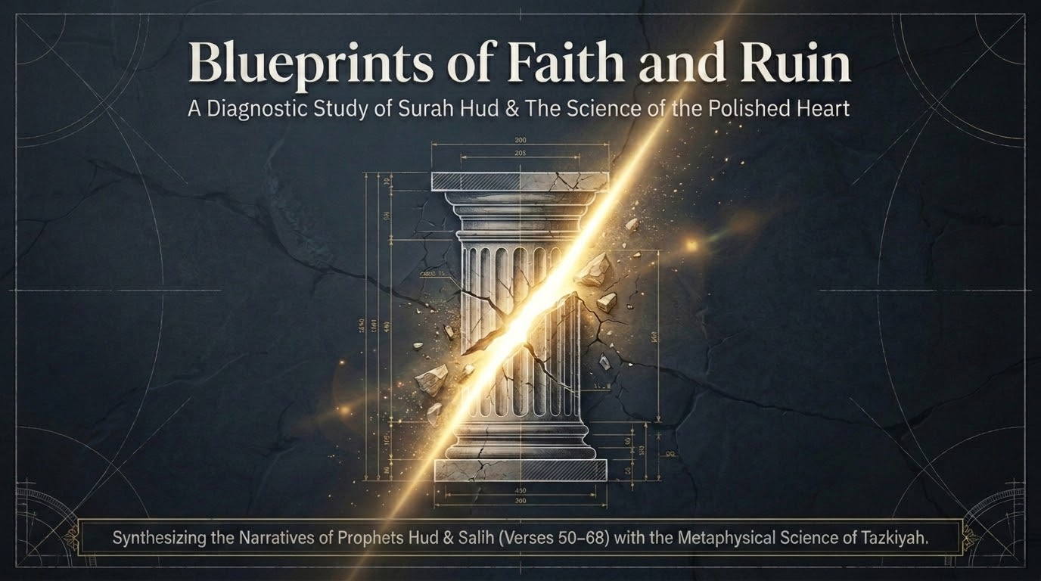

Notes:
Welcome to Part 3 of our walk-through of Sūrah Hūd. Part 1 laid the doctrinal foundation (vv. 1–24); Part 2 took the first and longest prophet-story, Nūḥ (vv. 25–49). Today we take the next two destruction-narratives as a matched pair: Hūd sent to ʿĀd (vv. 50–60) and Ṣāliḥ sent to Thamūd (vv. 61–68). The title, 'Blueprints of Faith and Ruin,' captures the method: we will read these as two case-studies in how a civilization is built and how it is erased, and then turn to the inner counterpart — 'the science of the polished heart' (tazkiyah) — in the closing third of the deck.
Hold the frame established in Part 1: Sayyid Qutb (In the Shade of the Qurʾān, vol. 9) shows that every prophet in this sūrah opens with one identical formula — 'worship Allah; you have no deity other than Him' — recurring almost verbatim for Nūḥ (v. 26), Hūd (v. 50), Ṣāliḥ (v. 61), and Shuʿayb (v. 84). So these stories are not separate tales; they are one argument restated across history. Maʿariful Qurʾān notes that although seven prophets appear, the sūrah is named for Hūd, which signals the special weight of his episode.
A note on method, as in the earlier parts: we draw on Saʿdī for direct verse-meaning, Maʿariful Qurʾān (Mufti Muḥammad Shafiʿ) for accessible synthesis and fiqh, Qutb for thematic and psychological depth, al-Wāḥidī for occasions of revelation, Ibn al-Jawzī (Zād al-Masīr) for the survey of classical opinions, and — strictly for balāghah — Zamakhsharī and Ibn ʿĀshūr. Tell the group: the goal is tadabbur and exposure, not mastery; ask for slow-downs as needed.

Slide 2
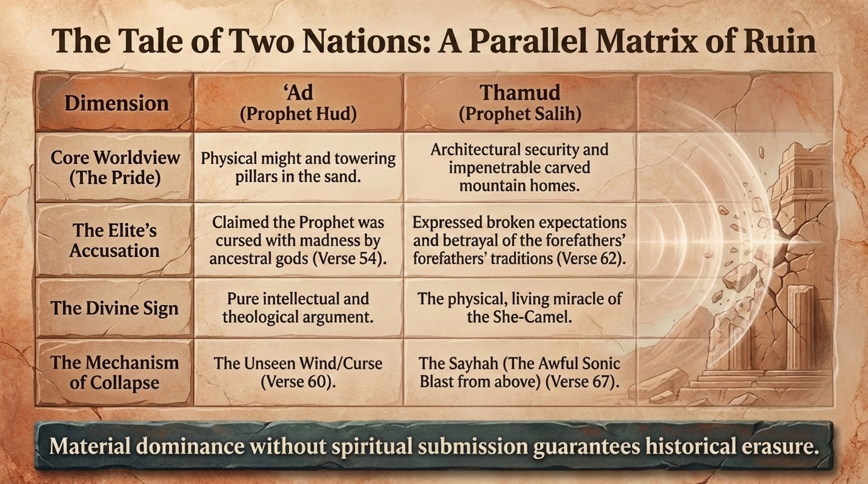
Notes:
This matrix is the diagnostic spine of the ʿĀd–Thamūd pairing. Both nations descend from the believers saved with Nūḥ (Qutb, vol. 9): they inherited monotheism and slid back into jāhiliyyah. The Qurʾān places their stories side by side because their pathologies rhyme. ʿĀd's defining sin is pride in physical might — Maʿariful notes they were renowned for build, strength, and bravery, and carved idols with their own hands; their boast is captured elsewhere as 'Who is mightier than us in strength?' (Fuṣṣilat 41:15). Thamūd's defining sin is pride in architectural security — they hewed secure homes into the rock (cf. al-Ḥijr).
Read the columns across: in each case the elite's accusation, the divine sign, and the mechanism of collapse differ in surface but share a structure. ʿĀd were destroyed by the unseen wind (cf. 69:6–7, the barren wind, rīḥ ṣarṣar); Thamūd by the sonic blast (al-ṣayḥah, v. 67). The slide's thesis — that material dominance without spiritual submission guarantees historical erasure — is exactly the lesson the sūrah draws at v. 60 and v. 68 with its twin refrain: 'away with ʿĀd... away with Thamūd.'
Tell the group to keep this matrix in view; we will return to it at the synthesis (slide 33) and again when we read 'the fate of Thamūd' against modern monuments (slide 36).

Slide 3
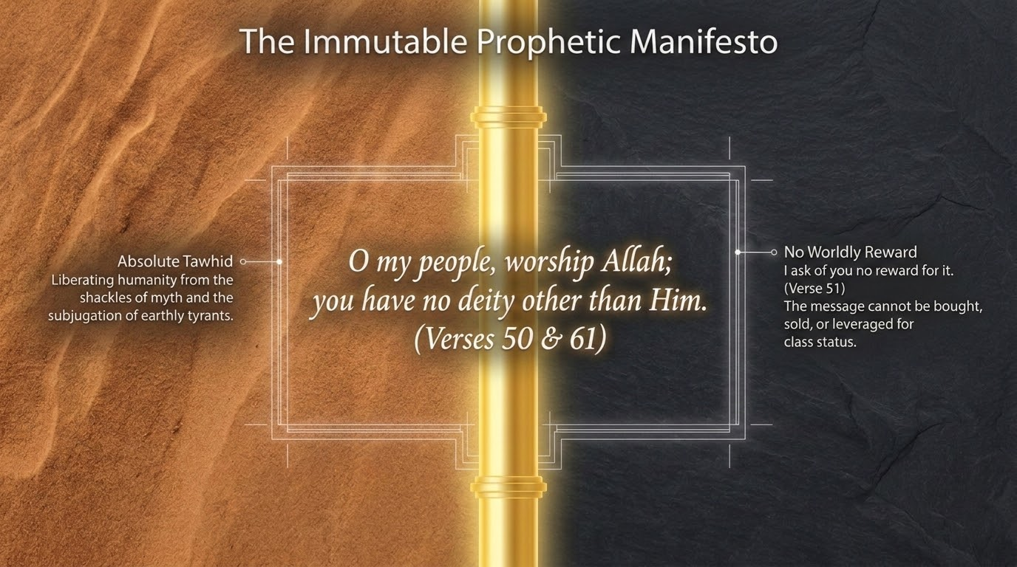
Notes:
Before the two case-studies, this slide isolates what the deck calls the 'immutable prophetic manifesto': the single sentence that opens both missions — 'O my people, worship Allah; you have no deity other than Him' (vv. 50 and 61). Qutb's point bears repeating here: the Qurʾān could have stated the doctrine once and summarized the rest, but it deliberately repeats the formula for each prophet to show that the core of every revealed message is identical, and that any deviation from absolute tawḥīd is the seed of ruin.
Pair this with the disavowal of payment that immediately follows in each story (v. 51, and echoed by Ṣāliḥ's posture in v. 63): the messenger seeks no worldly reward, which strips the call of any ulterior motive. The manifesto is therefore both doctrinal (worship Him alone) and ethical (with no price attached). Tell the group: the sameness is the argument — if every prophet in every age said exactly this, the burden of proof shifts onto those who reject it.

Slide 4
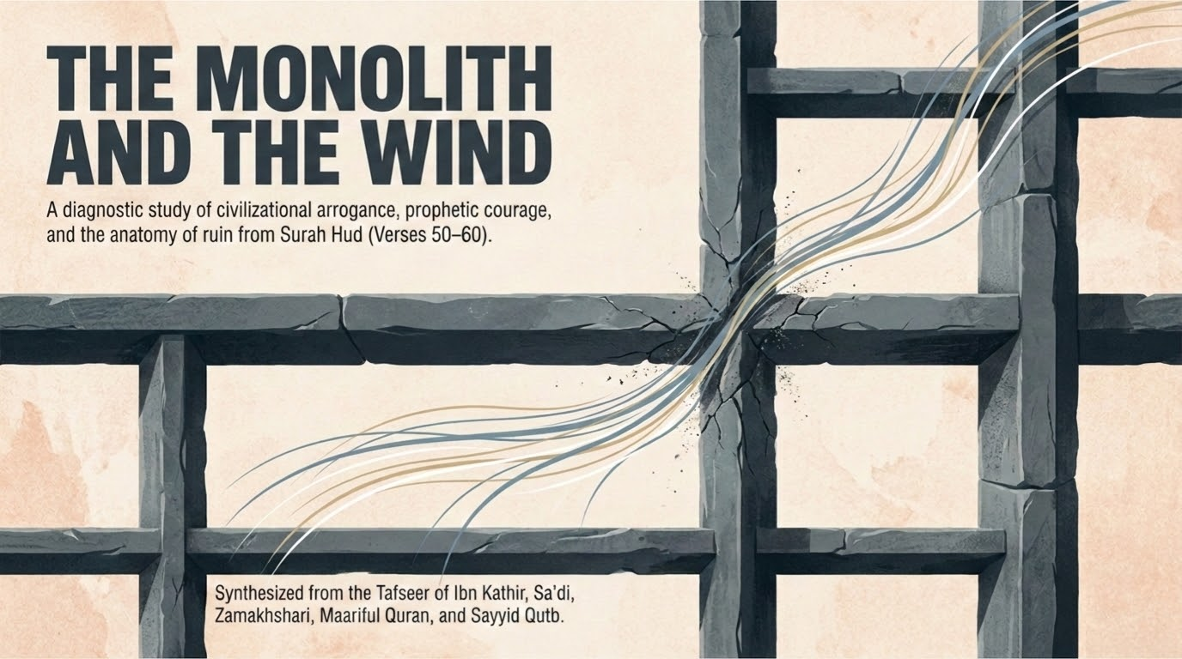

Notes:
This opens the ʿĀd case-study proper (vv. 50–60), framed by the deck as 'The Monolith and the Wind' — the monolith of ʿĀd's material self-confidence against the wind that would erase it. The sources named on the slide are the ones we lean on throughout: Ṭabarī, Saʿdī, Zamakhsharī, Maʿariful, and Sayyid Qutb.
Set the scene historically. Saʿdī (p. 294) locates ʿĀd as a well-known tribe in al-Aḥqāf — the sandy tracts — in the land of Yemen. Maʿariful adds that they were a people of exceptional physical build and courage who had nonetheless 'lost their reason to the extent that they worshipped gods they had carved out of stone with their own hands.' That contrast — superb strength yoked to absurd theology — is the anatomy this movement dissects.

Slide 5
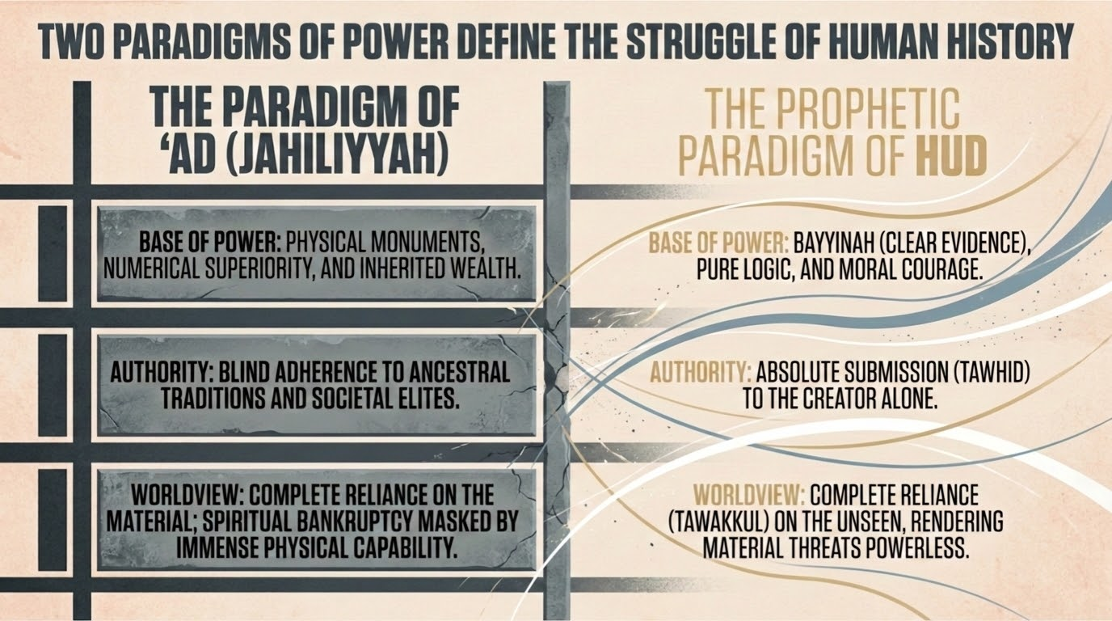
Notes:
The two-paradigm contrast is well grounded in the verses. The paradigm of ʿĀd (jāhiliyyah): a base of power in physical monuments and might, an authority rooted in blind ancestral tradition ('we will not leave our gods,' v. 53), and a worldview of total reliance on material capability. The paradigm of Hūd: a base of power in the bayyinah (clear evidence) from his Lord, an authority of absolute tawḥīd, and a worldview of complete reliance on Allah that renders material threats powerless (v. 56).
Qutb frames the encounter as a collision of two camps whose forces 'cannot be evenly matched': jāhiliyyah marshals its physical strength, but the one who calls to God relies on God's power, and God can deploy the weakest of natural elements — here, the wind — to undo the mightiest civilization 'from whence it does not expect.' Tell the group: the deck's two columns are not abstract; they are the actual fault-line that runs through every verse of this story.

Slide 6
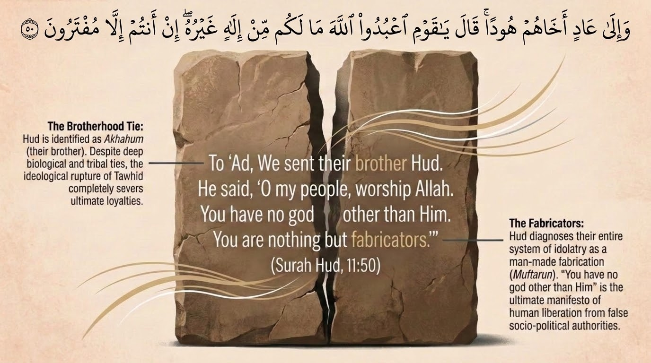
Notes:
Verse 50: 'And to ʿĀd [We sent] their brother Hūd (akhāhum Hūdan). He said: O my people, worship Allah; you have no deity other than Him. You are nothing but inventors of falsehood (muftarūn).' Saʿdī (p. 294) explains 'their brother' as brother in lineage, so that they would readily trust a man they knew to be truthful — the bond of kinship was meant to generate confidence and honest counsel. Qutb stresses the opposite outcome: the rupture between Hūd and his people, despite blood, dramatizes the sūrah's thesis that 'all ties are invalid when the bond of faith is non-existent.'
On 'you are nothing but inventors of falsehood' (muftarūn): Saʿdī clarifies that the fabrication is theirs, not Hūd's — they fabricated lies against Allah by worshipping carved gods and deeming it permissible; the false 'inventions' are precisely the idols (Qutb: 'False inventions are the idols you worship alongside God'). Note the sharp inversion the sūrah will sustain: the disbelievers will shortly accuse the prophet of fabrication (v. 53, 'you have brought us no clear evidence'), but the verse has already located the real iftirāʾ on their side.
Discussion: Hūd is sent as a 'brother.' What does it tell us that prophets are drawn from within the very people they warn — and that kinship, here, is not enough to save anyone whose deeds break the bond of faith?

Slide 7
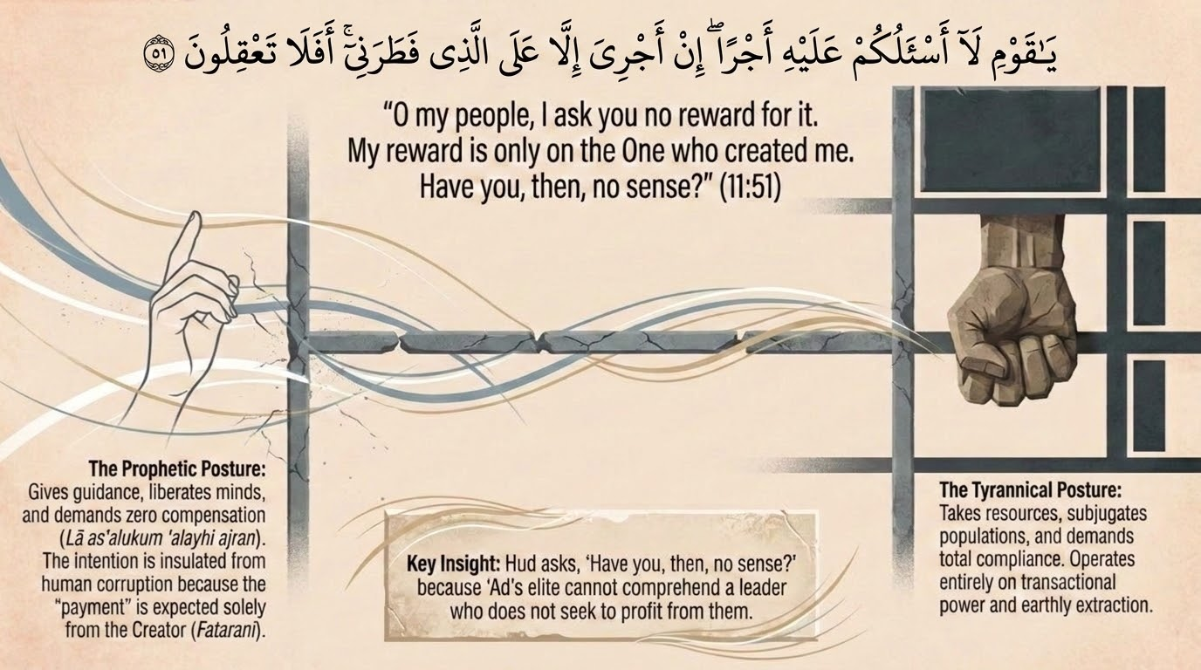
Notes:
Verse 51: 'O my people, I do not ask you for any reward for it; my reward is only upon the One who created me. Will you not then use reason (aflā taʿqilūn)?' Saʿdī (p. 294) reads this as Hūd removing every excuse: he asks no payment from their wealth 'lest you should say: this man wants to take our wealth. Rather I am calling you and teaching you for free.' Qutb observes that the very disavowal — 'No reward do I ask of you' — implies he had been accused of seeking personal gain; hence the rebuke, 'Will you not use your reason?'
Maʿariful turns this into the recurring daʿwah principle of the sūrah: almost every prophet declares he seeks no fee, and 'experience bears it out that those who take wages for their religious sermons leave the hearts of their audience unchanged.' The point is not that religious teachers may never be supported, but that the message itself must never be for sale, lest it be received as a transaction rather than as truth. Tadabbur: a call that costs the caller, and asks nothing of the called, carries an authority that no paid message can.

Slide 8
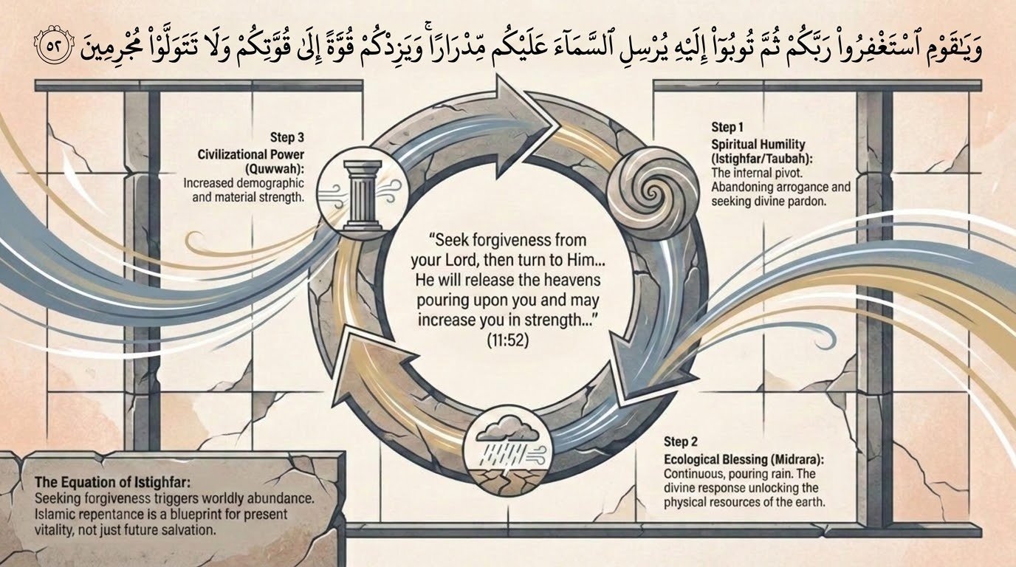
Notes:
Verse 52: 'O my people, seek the forgiveness of your Lord, then turn to Him in repentance; He will send the sky upon you in abundant showers (midrāran), and add strength to your strength (quwwatan ilā quwwatikum); and do not turn away as criminals.' This is the same triad — istighfār, then tawbah, then worldly increase — that opened the sūrah at v. 3 and that Nūḥ preached at 71:10–12. The deck's three steps track it exactly: spiritual humility (istighfār/tawbah), ecological blessing (midrār — pouring rain), and civilizational power (quwwah).
Qutb addresses the obvious question — how can rain and strength depend on seeking forgiveness, when they follow natural laws? On strength he answers directly: 'When people purify their hearts and commit themselves to good action, they inevitably add to their strength.' Saʿdī (p. 295) notes the promise of added strength was especially pointed for ʿĀd, who boasted 'Who is more powerful than us?' (Fuṣṣilat 41:15) — God offers to multiply the very thing they prided themselves on, if only they would submit. Maʿariful frames the verse as a blueprint for present vitality, not merely otherworldly salvation.
Contemporary application: the verse ties moral repair to material flourishing. Tell the group this is not a magic formula but a stated divine pattern (sunnah) — a people whose inner life is sound is given the conditions to thrive; a people who 'turn away as criminals' forfeit them.

Slide 9
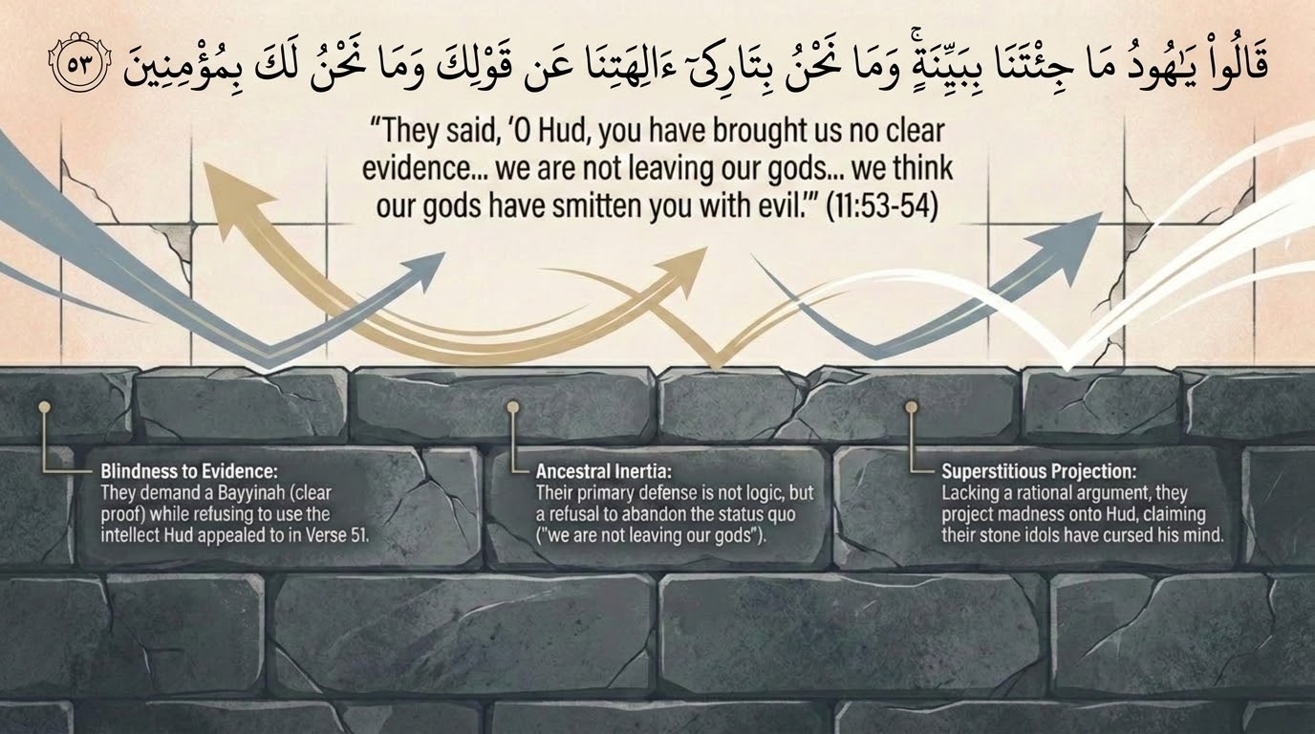
Notes:
Verses 53–54: 'They said: O Hūd, you have not brought us any clear evidence (bayyinah), and we are not going to forsake our gods on your word, nor will we believe in you. We only say that some of our gods have afflicted you with evil (iʿtarāka baʿḍu ālihatinā bi-sūʾ).' Saʿdī (pp. 295–296) dismantles the first claim: if they meant Hūd brought no sign at all, they were simply lying, for his call to pure tawḥīd, his flawless character, and his lone, fearless stand were themselves sufficient evidence; 'this sign is greater than mere extraordinary feats that some people think are the only real miracles.'
The slide's three diagnostics are precise: idolatrous confidence ('we will not forsake our gods'), ancestral inertia (the implicit appeal to the fathers' ways), and superstitious projection ('our gods have struck you with madness'). On that last charge Saʿdī is withering — they accused 'the most truthful of people, who brought the truest of truth' of insanity; he glorifies the One 'who put a seal on the hearts of the evildoers,' for only a sealed heart could say such a thing. Tadabbur: notice the move from 'we don't believe you' to 'you must be cursed/insane' — when an argument cannot be answered, the messenger's sanity is attacked instead.

Slide 10
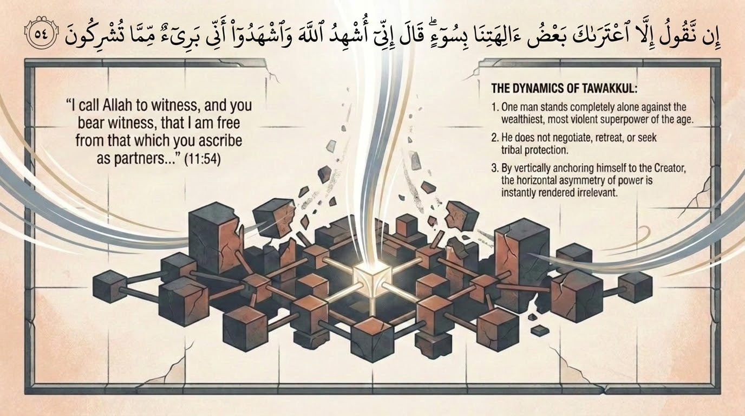
Notes:
Verses 54–56: Hūd's response is one of the great declarations of tawakkul in the Qurʾān. 'He said: I call Allah to witness, and you bear witness, that I am free (innī barīʾun) of what you associate besides Him. So plot against me, all of you, and give me no respite (fa-kīdūnī jamīʿan thumma lā tunẓirūn).' Saʿdī (p. 297): they were the powerful party who wished to extinguish his light by any means, 'but he did not care about them and paid them no heed, for they were helpless and unable to do him any harm.'
The slide's quoted phrase — 'plot against me, all of you, and give me no respite' — is the heart of it: one man, with no supporters, dares an entire hostile nation and their gods to do their worst. This is not bravado; it is the outward form of total reliance on Allah, which the next verse will ground in a stunning image (the forelock). Tell the group: the confidence is inversely proportional to his worldly means — he has nothing, and therefore fears nothing but God.

Slide 11
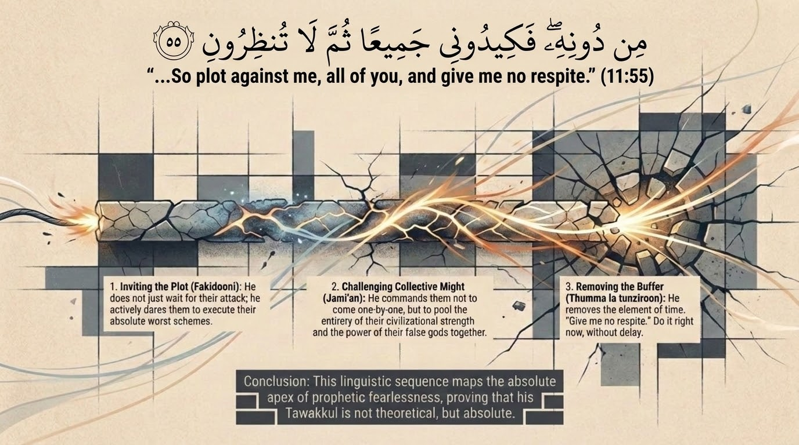
Notes:
Stay on the dynamics of v. 55 ('so scheme against me, all of you, and give me no respite'). The deck breaks the prophetic stance into four moves, all defensible from the text: he isolates himself as the sole target ('against me'), he challenges the collective might of the opposition ('all of you'), he refuses any delay or negotiation ('give me no respite'), and he names — by contrast — the tyrannical posture of those who silence dissent.
Qutb's reading: the prophet who relies on God 'need only fulfil his duties as best he can and leave matters to God with trust and confidence.' The challenge to 'scheme against me' is the believer's serenity made audible. Contemporary application: there is a difference between reckless provocation and the calm refusal to be intimidated; what licenses Hūd's defiance is not his strength but his certainty about whose hand actually holds power — which v. 56 will now make explicit.

Slide 12
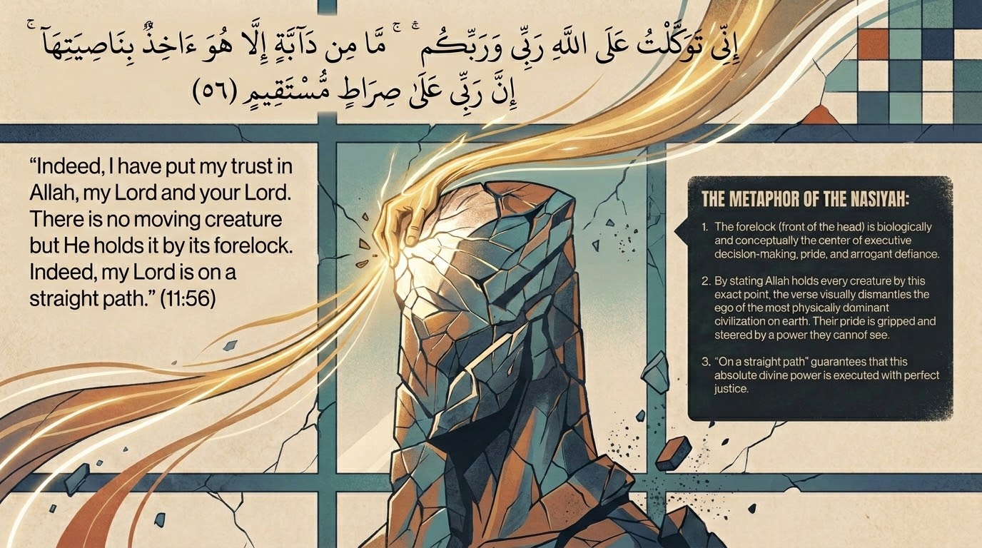
Notes:
Verse 56 is the theological summit of the ʿĀd story: 'Indeed, I have placed my trust in Allah, my Lord and your Lord. There is no creature (dābbah) but He holds it by its forelock (illā huwa ākhidhun bi-nāṣiyatihā). Indeed, my Lord is upon a straight path.' Maʿariful glosses the forelock-image as total dominion: every living thing, including Hūd's enemies, is held by the front of its head — the seat of will and motion — so nothing can move against him except by God's leave.
The image is deliberately physical and intimate: to seize a beast's nāṣiyah (forelock) is to control it completely, the way one leads an animal by the hair of its brow. Hūd's enemies imagine they hold the power; the verse says God holds them. And the clause 'my Lord is upon a straight path' (ṣirāṭ mustaqīm) means His governance is perfectly just — His power is never arbitrary. Tadabbur: place this beside v. 55. Hūd can invite his foes to plot freely precisely because he knows the leash of every plotter is in his Lord's hand. Reliance (tawakkul) is not passivity; it is acting on the knowledge of who actually holds the forelock.

Slide 13
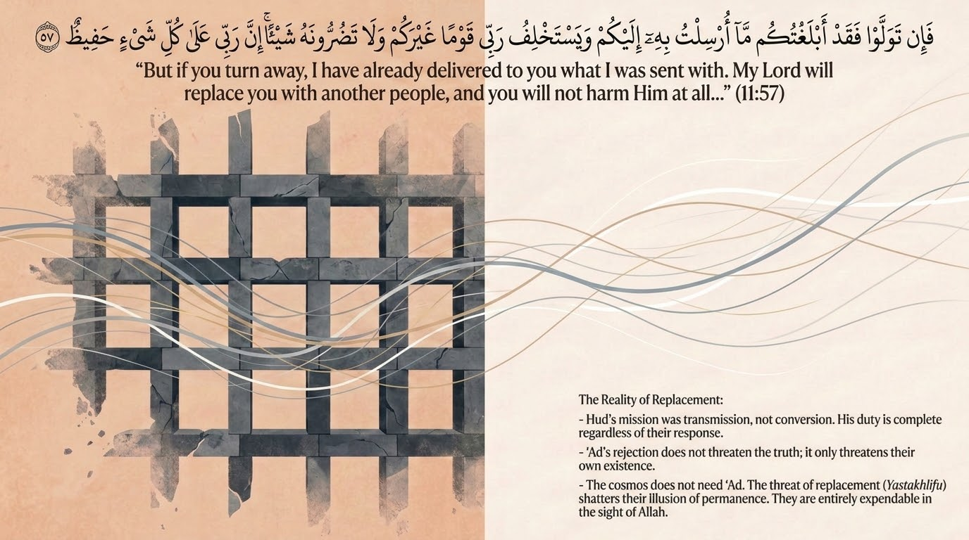
Notes:
Verse 57: 'But if you turn away, then I have already conveyed to you that with which I was sent. My Lord will replace you with another people, and you will not harm Him in the least. Indeed, my Lord is, over all things, a Guardian (Ḥafīẓ).' Two lessons sit here. First, the prophet's responsibility is balāgh — faithful delivery — and he declares it discharged ('I have already conveyed'); the outcome is not his burden. Saʿdī ties the closing name Ḥafīẓ to God's perfect preservation and oversight of all things.
Second, the warning of replacement (yastakhlif rabbī qawman ghayrakum) states a divine pattern: a people who reject guidance are not indispensable; God can raise another community in their place, and their refusal harms only themselves ('you will not harm Him at all'). Contemporary application: this is sobering for any community that imagines its own permanence — vitality is a trust, not an entitlement, and it can pass to others. Tell the group this anticipates the actual replacement narrated in v. 58–60.

Slide 14
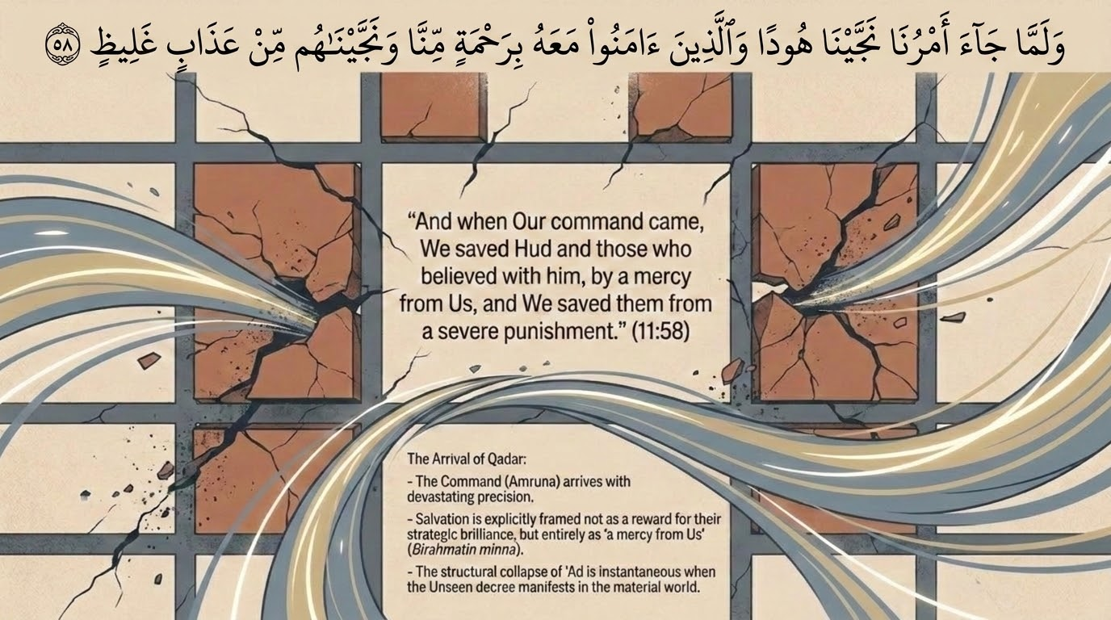
Notes:
Verse 58: 'And when Our command came, We saved Hūd and those who believed with him, by a mercy from Us; and We saved them from a harsh punishment (ʿadhāb ghalīẓ).' The deck rightly highlights the double salvation — saved by mercy, and saved from the severe punishment — the same structure we will see for Ṣāliḥ in v. 66. Note the word ghalīẓ ('harsh, gross, thick'): elsewhere the Qurʾān specifies ʿĀd's end as the rīḥ ṣarṣar, the howling barren wind (69:6–7; cf. 41:16), that swept for seven nights and eight days.
Maʿariful notes a point worth flagging for the group: ʿĀd are described in this sūrah as destroyed in association with a 'command,' while elsewhere their ruin is linked to a wind, and al-Muʾminūn (23) mentions a ṣayḥah (cry) for a people; commentators allow that more than one form of punishment may have combined. The constant across accounts is that the believing remnant was rescued first, by mercy, before the decree fell — salvation precedes destruction in the Qurʾānic pattern.

Slide 15
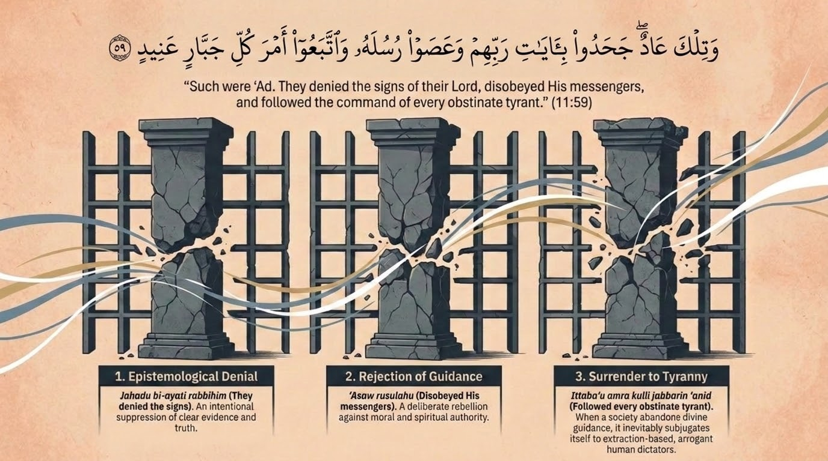
Notes:
Verses 59–60: 'And that was ʿĀd. They rejected the signs of their Lord, disobeyed His messengers, and followed the command of every obstinate tyrant (kulli jabbārin ʿanīd).' The deck's three-fold breakdown matches the verse exactly: epistemological denial (they rejected the āyāt), rejection of guidance (they disobeyed the messengers — note the plural, rusul, since rejecting one is rejecting all), and surrender to tyranny (they obeyed every jabbār ʿanīd).
Maʿariful underscores the political diagnosis in 'every obstinate tyrant': ʿĀd's ruin was not only theological but social — they handed their allegiance to arrogant, unyielding power-holders rather than to the truth. This is one of the sūrah's recurring themes (compare Pharaoh later, v. 97, 'they followed Pharaoh's command'). Tadabbur: idolatry of stone and idolatry of strongmen travel together; a people who will not submit to God end up submitting to whoever shouts loudest. Discussion: where do we see 'following every obstinate tyrant' — in politics, in culture, in our own deference to whatever is dominant?

Slide 16
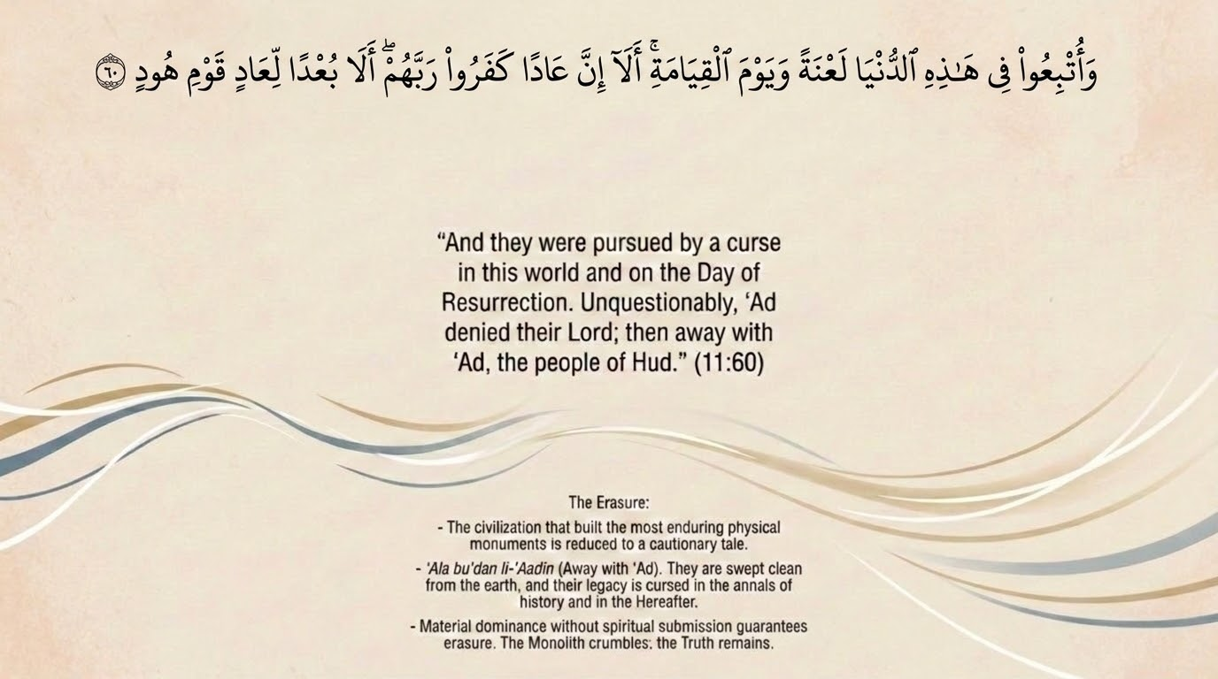
Notes:
Verse 60 seals the ʿĀd story with the sūrah's signature refrain: 'And they were pursued by a curse in this world and on the Day of Resurrection. Unquestionably, ʿĀd denied their Lord; so away (buʿdan) with ʿĀd, the people of Hūd.' Saʿdī (p. 300) explains the curse as their being driven 'far from all that is good and near to all that is evil,' in both worlds. The same closing formula will recur verbatim for Thamūd (v. 68) and stands behind the earlier curses on the fabricators (v. 18).
Note the bitter dignity of the phrase 'the people of Hūd' (qawmu Hūd): they are remembered, finally, by the name of the very prophet they rejected. The man they dismissed becomes the permanent label of their ruin. Tell the group: this is the sūrah's verdict-language — buʿdan ('away with them') is the divine counterpart to the worldly applause they once chased. Worldly might earned them a curse that outlasts the world.

Slide 17
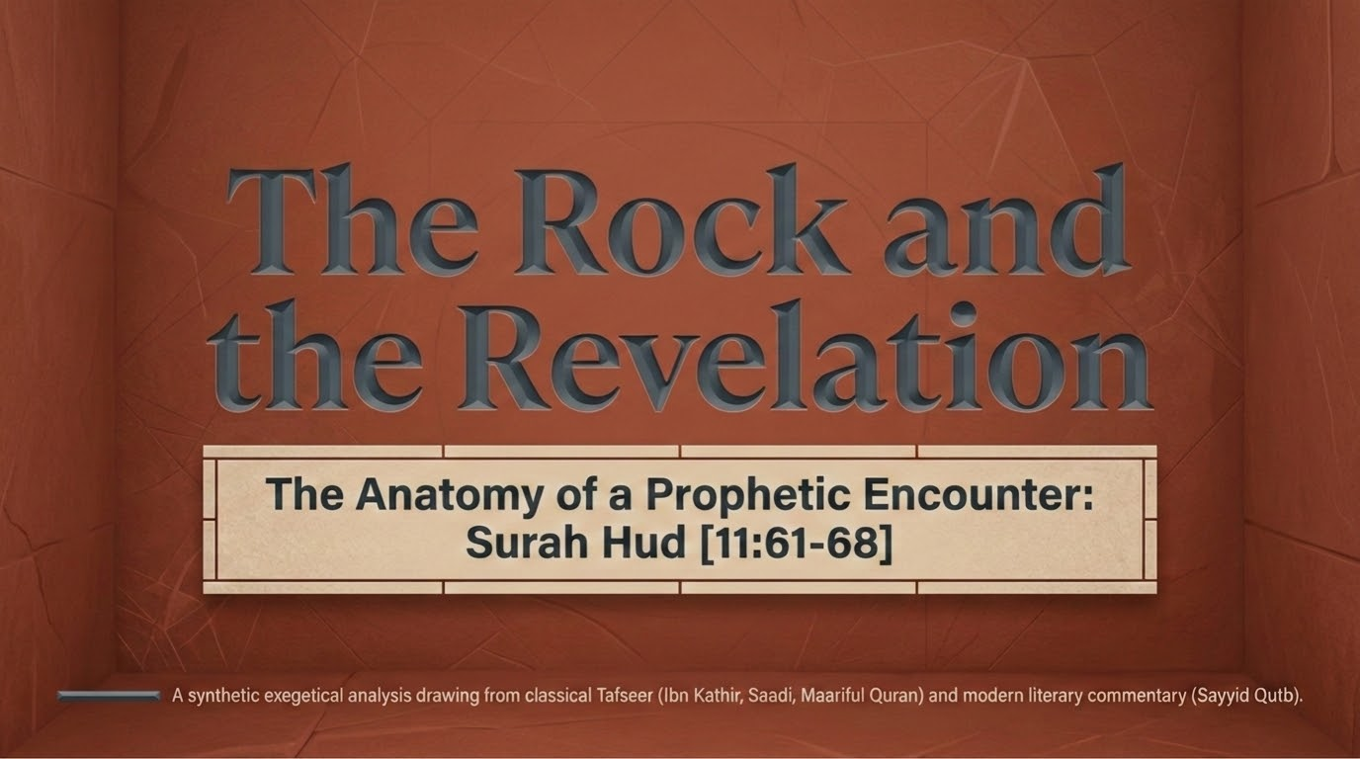
Notes:
This slide opens the second case-study: Ṣāliḥ and Thamūd, vv. 61–68, framed by the deck as 'The Rock and the Revelation' — the rock into which Thamūd carved their security, against the revelation that called them beyond it. As before, the sources are our standing library: Saʿdī, Maʿariful, Qutb, with Ibn al-Jawzī and Zamakhsharī for classical and linguistic depth.
A bridge for the group: where ʿĀd's pride was in raw strength, Thamūd's was in mastery — engineering, permanence, the confidence of a people who could hew palaces from cliffs (cf. al-Ḥijr, between Madinah and Tabūk, per Qutb). The 'rock' is the perfect emblem of a security that feels unassailable. The story will show how quickly a single 'cry' undid it.

Slide 18
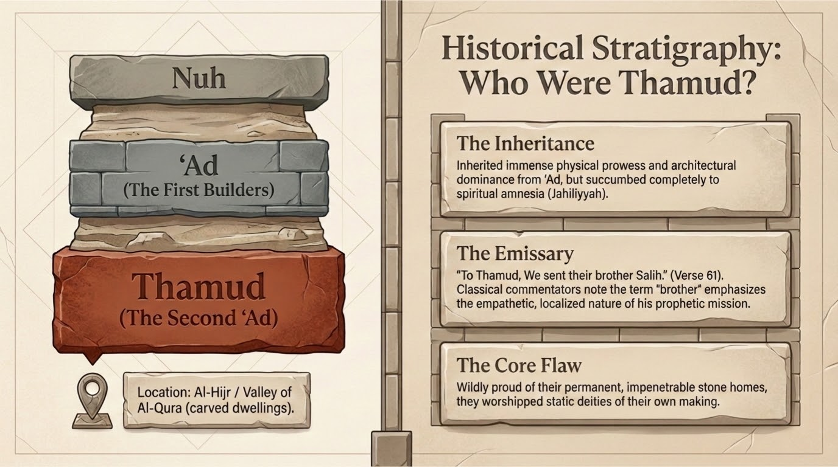
Notes:
Historical stratigraphy, as the deck calls it: who were Thamūd? Saʿdī (p. 300) identifies them as 'the second ʿĀd,' the well-known tribe who dwelt in al-Ḥijr (the Rocky Tract) and the Valley of al-Qurā. The layered framing — Nūḥ, then ʿĀd (the first great builders), then Thamūd (the second ʿĀd) — places them in a recurring cycle: each generation inherits monotheism, prospers, grows arrogant in its mastery, and falls.
Maʿariful notes Thamūd were 'another branch of the tribe of ʿĀd,' and that they would demand of Ṣāliḥ a custom-made miracle (the she-camel from the rock) as their condition for belief. The 'core flaw' the deck names is the inheritance turned to entitlement: a people who mistake God-given capability for self-made achievement — precisely the error v. 61 will correct with the word istaʿmarakum.

Slide 19
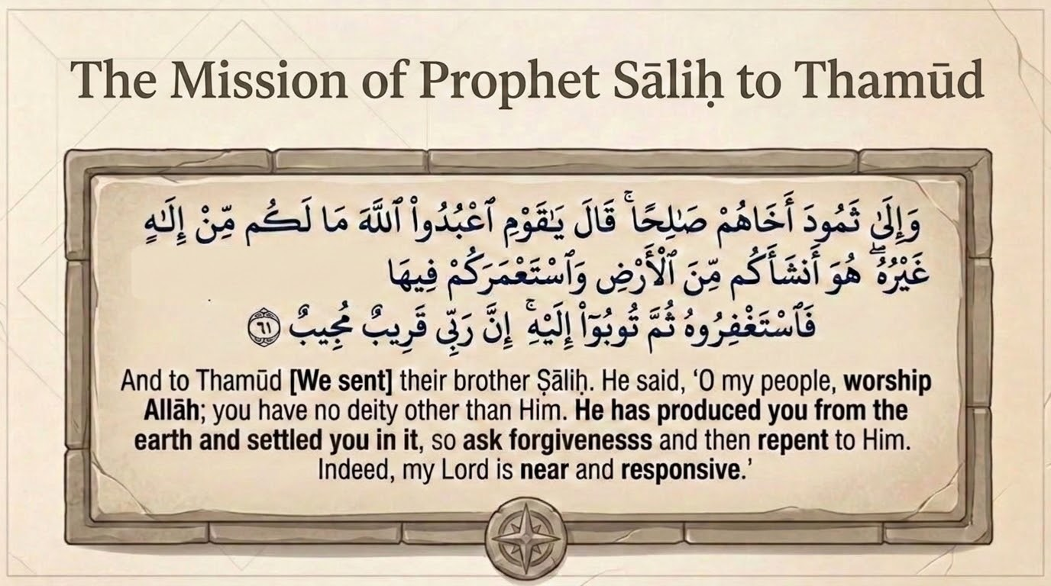
Notes:
Verse 61: 'And to Thamūd [We sent] their brother Ṣāliḥ. He said: O my people, worship Allah; you have no deity other than Him. He produced you from the earth (ansha'akum min al-arḍ) and settled you in it (istaʿmarakum fīhā); so seek His forgiveness, then turn to Him in repentance. Indeed, my Lord is Near, Responsive (Qarīb Mujīb).' Saʿdī (p. 300) reads 'their brother in lineage Ṣāliḥ, the slave of Allah and His Messenger,' calling them to worship Allah alone, the only deity among the inhabitants of the heavens and the earth.
Two phrases carry the slide's weight and the next two slides. Ansha'akum min al-arḍ: He originated you from the earth (Ādam was created from clay, and every body is nourished from what the earth yields). Istaʿmarakum fīhā: He settled you in it and gave you the means and mandate to develop and cultivate it — the root ʿ-m-r yields ʿimārah, building and civilization. And the verse closes the call to istighfār with two of the most consoling names: Qarīb (Near) and Mujīb (the One who answers), treated on slide 21.

Slide 20
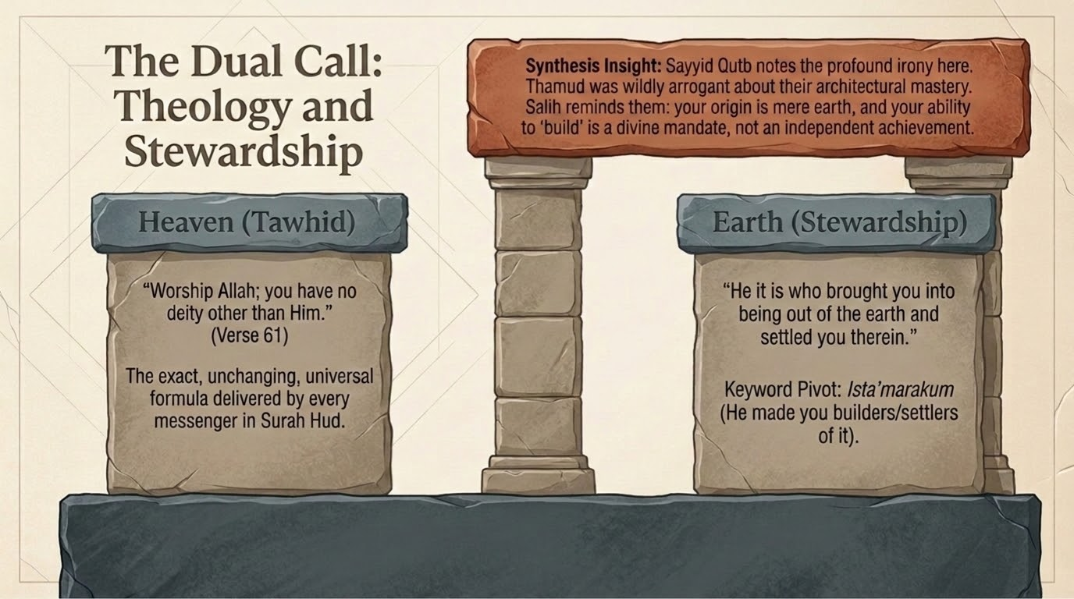
Notes:
The deck's 'dual call' reads v. 61 as theology plus stewardship. Heaven: tawḥīd — 'worship Allah; you have no deity other than Him,' the unchanging formula of every messenger in the sūrah. Earth: stewardship — 'He produced you from the earth and settled you in it.' The keyword pivot is istaʿmarakum: He made you its builders and settlers, and charged you with its cultivation.
The synthesis insight is Qutb's irony, and it is sharp: Thamūd were wildly proud of their architectural mastery, yet Ṣāliḥ reminds them that their very ability to build is a divine grant, not an independent achievement — 'He settled you in it.' The hand that carved the rock was itself produced from the earth and enabled by its Maker. Tadabbur: this is the precise antidote to the ʿĀd–Thamūd disease. Stewardship (istiʿmār) means we develop the earth as trustees answerable to its Owner, not as self-made lords. A believing engineer, architect, or builder reads v. 61 as a job description: build, but as one settled here by God, for God.

Slide 21
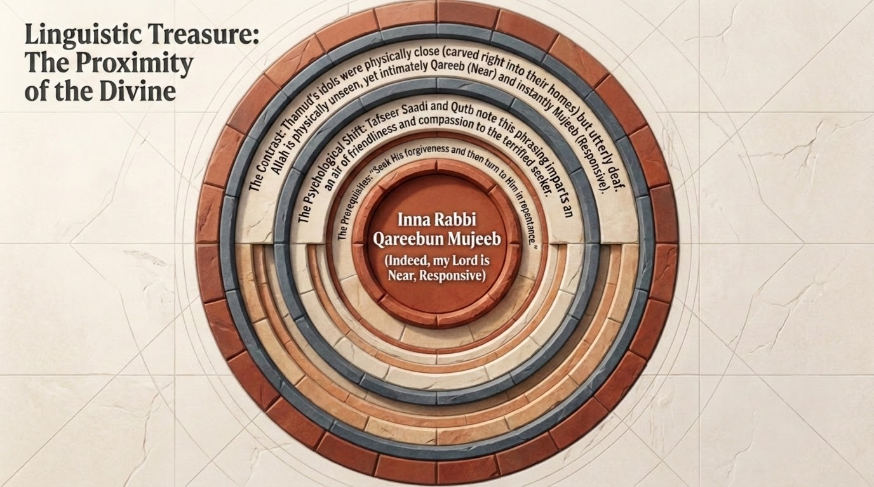
Notes:
Linguistic treasure: the divine names that close v. 61 — Qarīb Mujīb (Near, Responsive). Saʿdī ties them to the command to seek forgiveness: turn to Him, 'for verily my Lord is Ever-Near, Responsive.' The pairing is pastoral and exact — Qarīb removes the fear that God is too remote to hear (cf. 2:186, 'when My servants ask you about Me, indeed I am near'); Mujīb removes the fear that, even if heard, one will not be answered.
Note the rhetorical placement: these names appear at the end of a call to repentance, not a call to dread. The God who could be named here as Mighty or Avenging is instead named Near and Responsive — the door is open before the punishment is ever mentioned. Tadabbur: the same God who will shortly destroy Thamūd by a single cry first introduces Himself to them as Near and Answering. Mercy precedes wrath in the order of the call; the wrath comes only after the door of nearness is slammed from their side.

Slide 22
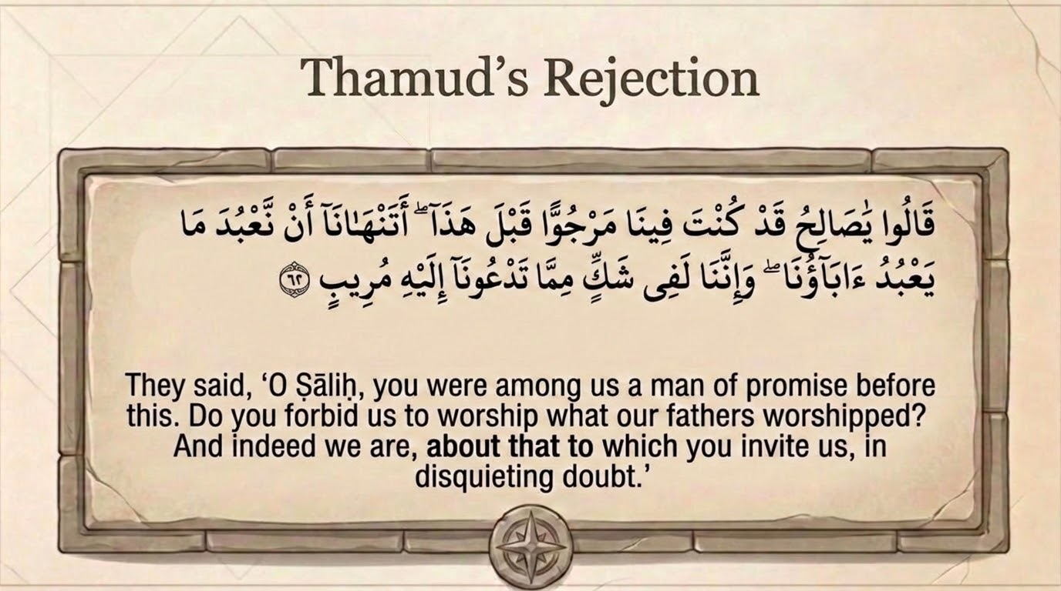
Notes:
Verse 62: 'They said: O Ṣāliḥ, you were among us a man of promise (marjuwwan) before this. Do you forbid us to worship what our fathers worshipped? And indeed we are, about that to which you invite us, in disquieting doubt (shakkin murīb).' The tragedy is in the first phrase. Maʿariful explains marjuwwan: before he claimed prophethood they had great hopes in him — they expected him to become a great leader and reformer, because Allah grooms His prophets from childhood so that 'whoever looks at them, loves and respects them.'
Maʿariful draws the explicit parallel to the Prophet Muḥammad ﷺ, whom all Arabia called al-Amīn (the trustworthy) before his mission — 'it was only when he announced his prophethood and prohibited idol-worship that everyone turned hostile.' Qutb makes the same link: Thamūd's 'great hopes' in Ṣāliḥ mirror Quraysh's trust in Muḥammad, abandoned the moment he called them to God alone. Tadabbur: a community will praise a sincere person right up until his sincerity costs them their idols — then the very trust they professed becomes the grievance ('we expected better of you'). The appeal to 'what our fathers worshipped' is the recurring shield of inherited error.

Slide 23
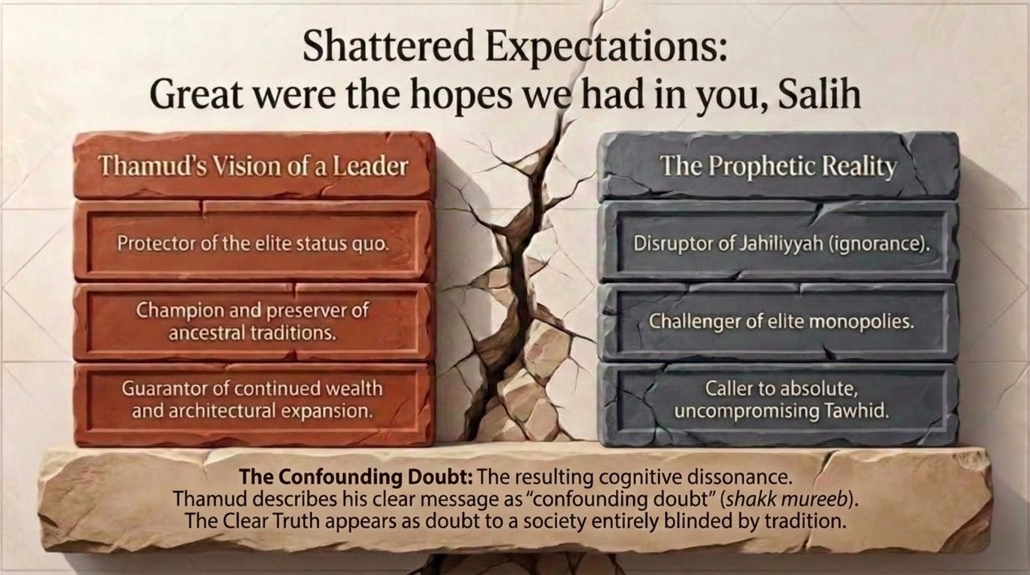
Notes:
The deck names this 'shattered expectations': Thamūd's vision of a leader against the prophetic reality. They wanted a reformer who would amplify their greatness; they got a messenger who relativized it before God. The slide's 'confounding doubt' is the verse's shakk murīb — a doubt that itself disturbs and unsettles (the root r-y-b denotes anxious, restless suspicion, not calm inquiry).
This is a precise psychological observation: their problem was not lack of evidence but the cognitive dissonance of a society 'blinded by tradition' — the man they had ranked highest was now asking them to abandon the very things that anchored their identity. Tadabbur: note the difference between shakk murīb (anxious, defensive doubt that wants the claim to be false) and honest inquiry that wants to know the truth. The same distinction governed the chieftains of Nūḥ (Part 2, the jadal-vs-nuṣḥ contrast). Doubt is not the sin; it is what one does with it.

Slide 24
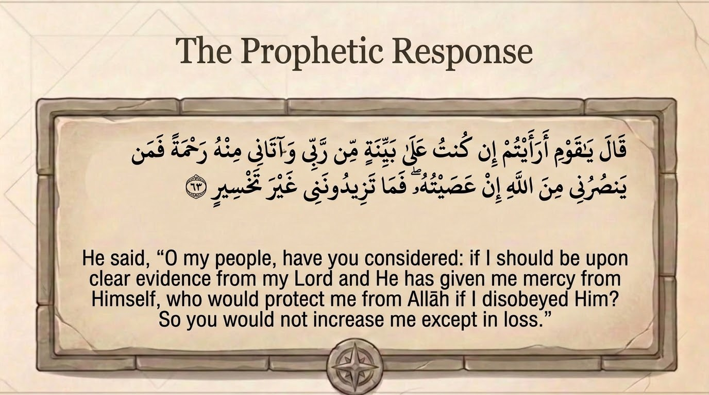
Notes:
Verse 63: 'He said: O my people, have you considered — if I am upon clear evidence (bayyinah) from my Lord, and He has given me mercy from Himself, who would protect me from Allah if I disobeyed Him? So you would not increase me except in loss (ghayra takhsīr).' Saʿdī (p. 303) reads bayyinah as evidence and certainty, and the 'mercy from Himself' as the gift of His message and revelation. Qutb expands the logic: 'if I have clear proof... who will protect me from God if, in order to preserve your hopes in me, I disobey Him by not conveying His message?'
The closing phrase is pointed: 'you would only increase me in loss' (takhsīr). Were Ṣāliḥ to abandon the message to keep their goodwill, he would incur double ruin — God's anger and the forfeiture of his prophetic honour, as Qutb puts it, 'a compound loss.' Tadabbur: the crowd offered him their renewed approval as the price of silence; he answers that their approval, set against God's, is not a gain but a deepening loss. Whose 'increase' are we actually pursuing?

Slide 25
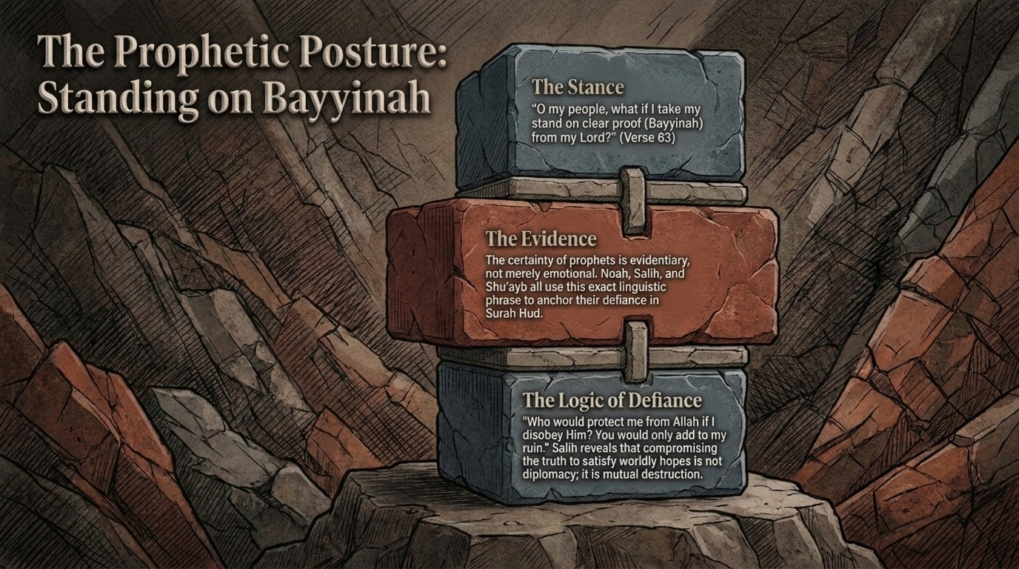
Notes:
This recurring 'prophetic posture' slide isolates the formula we have now met three times: Nūḥ at v. 28, and here Ṣāliḥ at v. 63 — 'have you considered, if I am upon a bayyinah from my Lord...' Qutb notes the same opening will recur from Shuʿayb at v. 88; it is the prophets' shared signature, an invitation to reason (a-raʾaytum, 'have you considered?') anchored in revelation rather than in the speaker's person.
The slide's columns — the proof he stands on, the mercy he was given, the loss he refuses to incur — track the three clauses of v. 63. Cross-reference v. 17 of Part 1, where ʿalā bayyinatin min rabbihi marked the believer's stance generally. Tell the group: the recurrence is the point. Standing on clear evidence, claiming no private power, and leaving the verdict to God is not one prophet's temperament; it is the divinely-modelled method of calling to the truth.

Slide 26
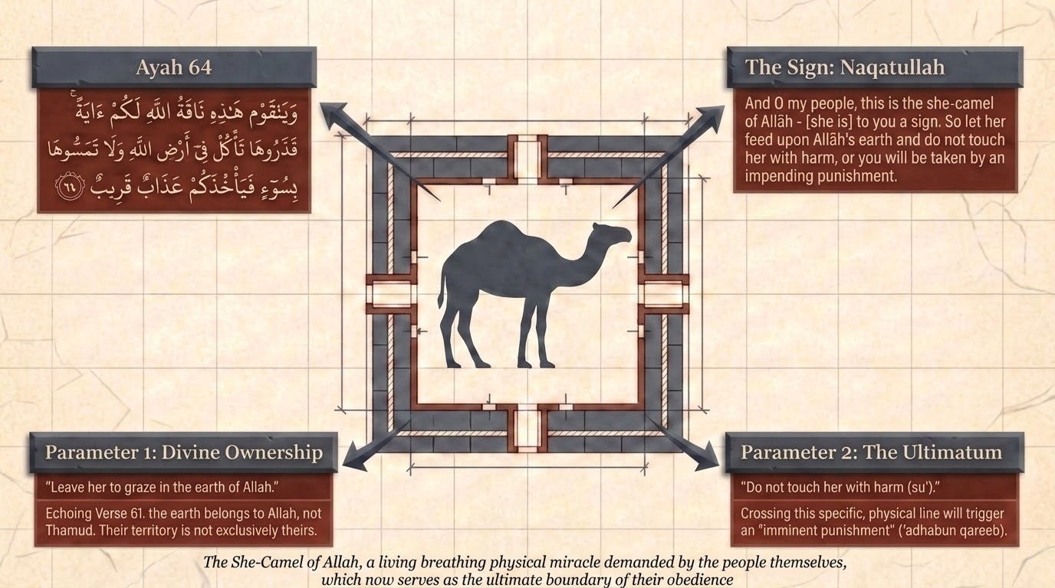
Notes:
Verses 64–65: 'And O my people, this is the she-camel of Allah (nāqatu llāh) — a sign for you. So let her graze in Allah's land, and do not touch her with harm, lest a near punishment (ʿadhāb qarīb) seize you.' The deck's two parameters are exact. Parameter 1, divine ownership: she is the she-camel of Allah, grazing in the land of Allah — Saʿdī (p. 303) notes Thamūd bore no cost for her upkeep; her sustenance was not their responsibility. Their land was never exclusively theirs.
Parameter 2, the ultimatum: 'do not touch her with harm' — a single prohibition, with an immediate, looming penalty (ʿadhāb qarīb, a 'near' punishment). Saʿdī records the arrangement classical sources preserve: she had one day to drink from the well and the people another, and her milk sufficed them on her day. Maʿariful relates the demand-history: Thamūd had insisted Ṣāliḥ produce a she-camel of specified description from the rock, and Allah, in His power, split the rock and brought her forth bearing exactly those features — then forbade them to harm her. The miracle they designed became the test they failed.

Slide 27
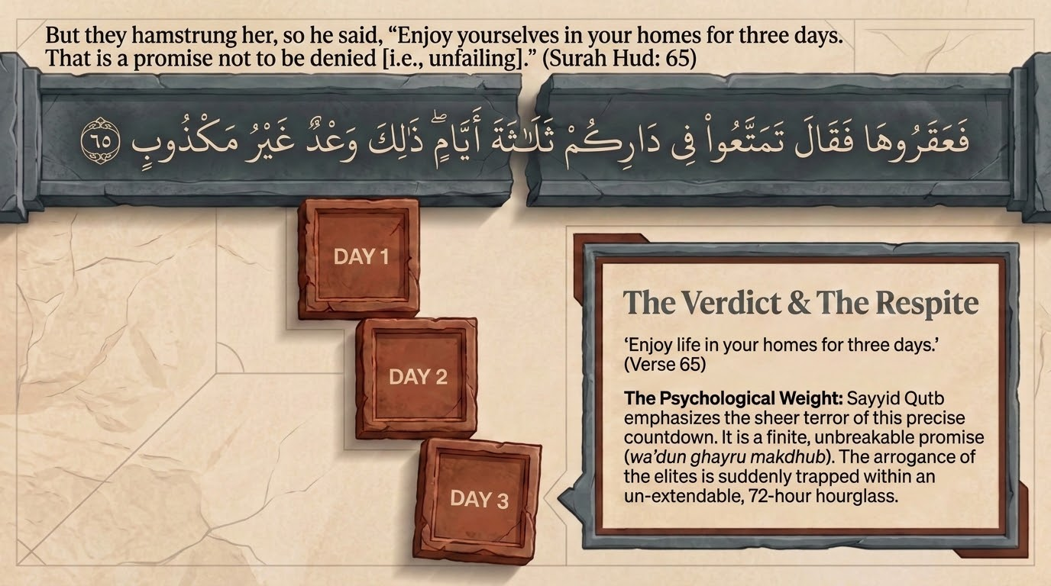
Notes:
Verse 65: 'But they hamstrung her (faʿaqarūhā), so he said: Enjoy yourselves in your homes for three days. That is a promise not to be denied (ghayru makdhūb).' Qutb notes the Arabic ʿaqr indicates they struck her legs with swords before killing her — an act of deliberate cruelty — and that the text 'does not allow for any time passing between the appearance of the she-camel and their killing of her': the sign moved them not at all.
The three-day respite is the deck's countdown. Maʿariful, citing Qurṭubī, records that these were Thursday, Friday, and Saturday, with the punishment descending on Sunday. The respite is itself a mercy — a final, dated warning — and its precision ('that is a promise not to be denied') removes any hope that it was idle. Tadabbur: a fixed term to set one's affairs right is a gift, not a reprieve from accountability; Thamūd spent theirs in their homes, unrepentant. What would three named days do to how we live?

Slide 28
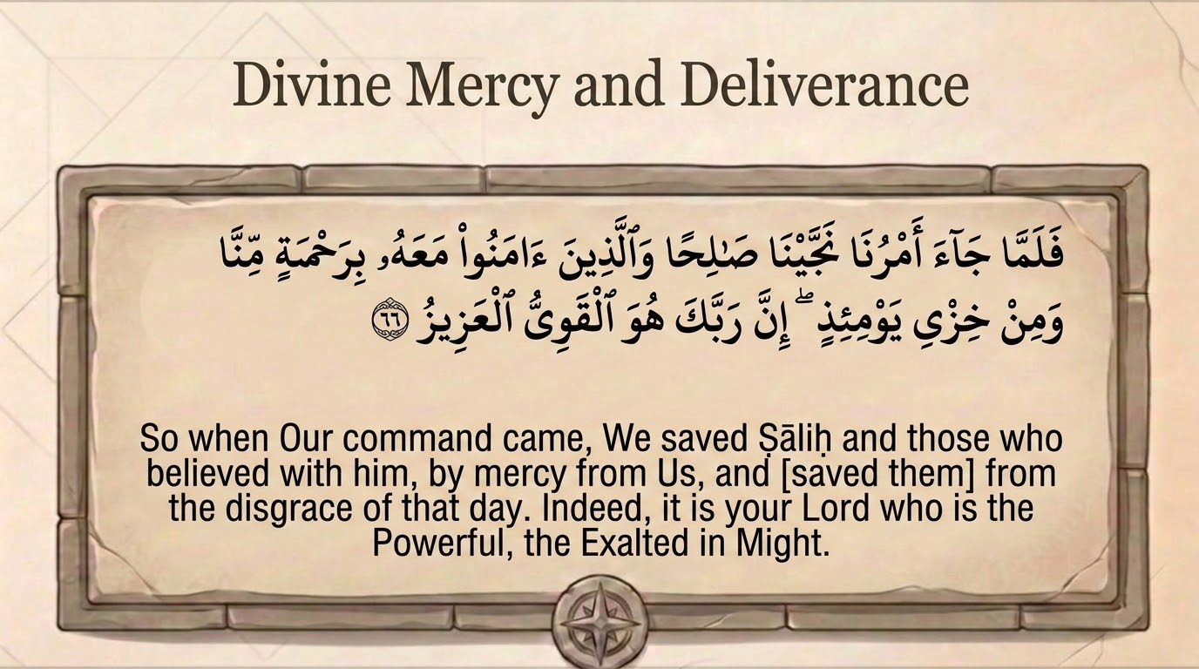
Notes:
Verse 66: 'So when Our command came, We saved Ṣāliḥ and those who believed with him, by a mercy from Us, and from the disgrace of that day (khizyi yawmiʾidhin). Indeed, your Lord — He is the Powerful, the Exalted in Might (al-Qawiyy al-ʿAzīz).' The structure mirrors Hūd's deliverance (v. 58): salvation by mercy comes first, then the destruction of the rest. Qutb notes the believers were spared not only death but 'the humiliating destiny' of those who died frozen in their places.
The closing names answer the whole arc of Thamūd's pride. They trusted their own quwwah (strength) and ʿizzah (might) carved into the rock; the verse returns both words to their Owner — al-Qawiyy (the truly Strong), al-ʿAzīz (the truly Mighty). Qutb: 'Nothing can stand in His way, and no people, powerful as they may be, can escape His judgement. Those who are on His side will always have their dignity intact.' Tadabbur: every attribute a people idolizes in itself is, in truth, a borrowed name of God; the day of reckoning simply returns the name to its rightful Owner.

Slide 29
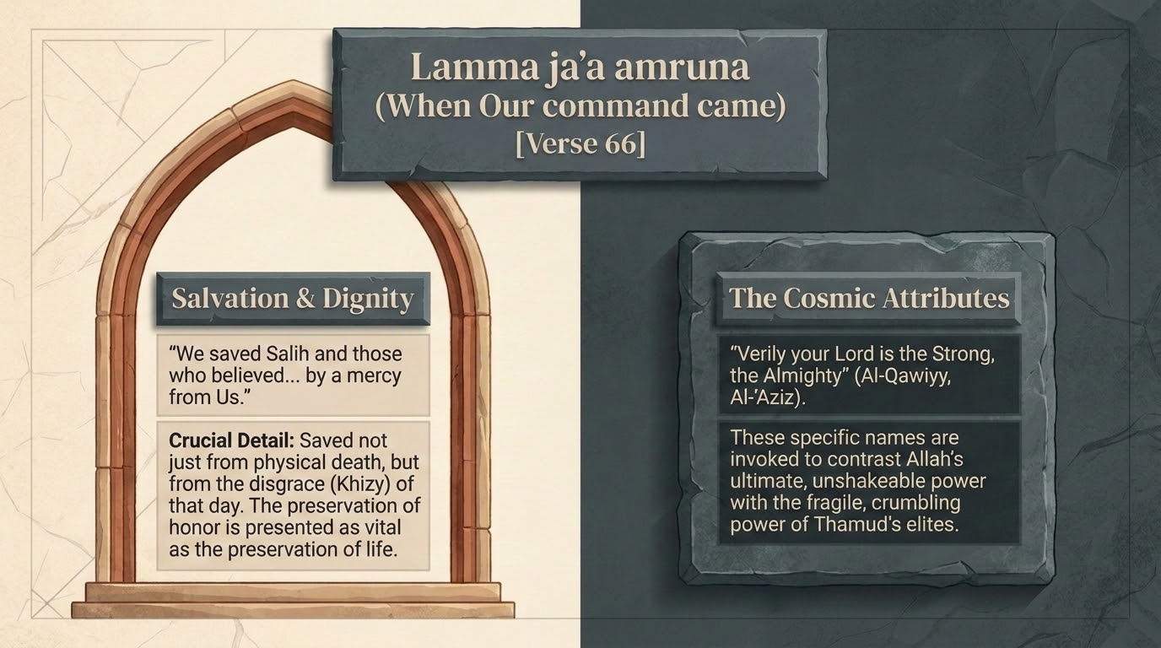
Notes:
This slide lingers on the opening of v. 66 — lammā jāʾa amrunā, 'when Our command came' — pairing salvation and dignity with the cosmic attributes that close the verse. The phrase 'Our command' (amr) is the sūrah's repeated hinge between the era of warning and the moment of decree (we saw it at v. 40 for Nūḥ, v. 58 for Hūd); when it 'comes,' the time for response is over.
Saʿdī's emphasis: the believers were saved 'by a mercy from Us' and 'from the disgrace of that day' — the salvation is specific, named, and complete. Tell the group to notice how consistently the sūrah pairs rescue with the divine names that frame it: here al-Qawiyy al-ʿAzīz, so that deliverance is read not as luck but as the act of the One whose strength and might are absolute. The believer's safety rests on God's power, not on the believer's own.

Slide 30
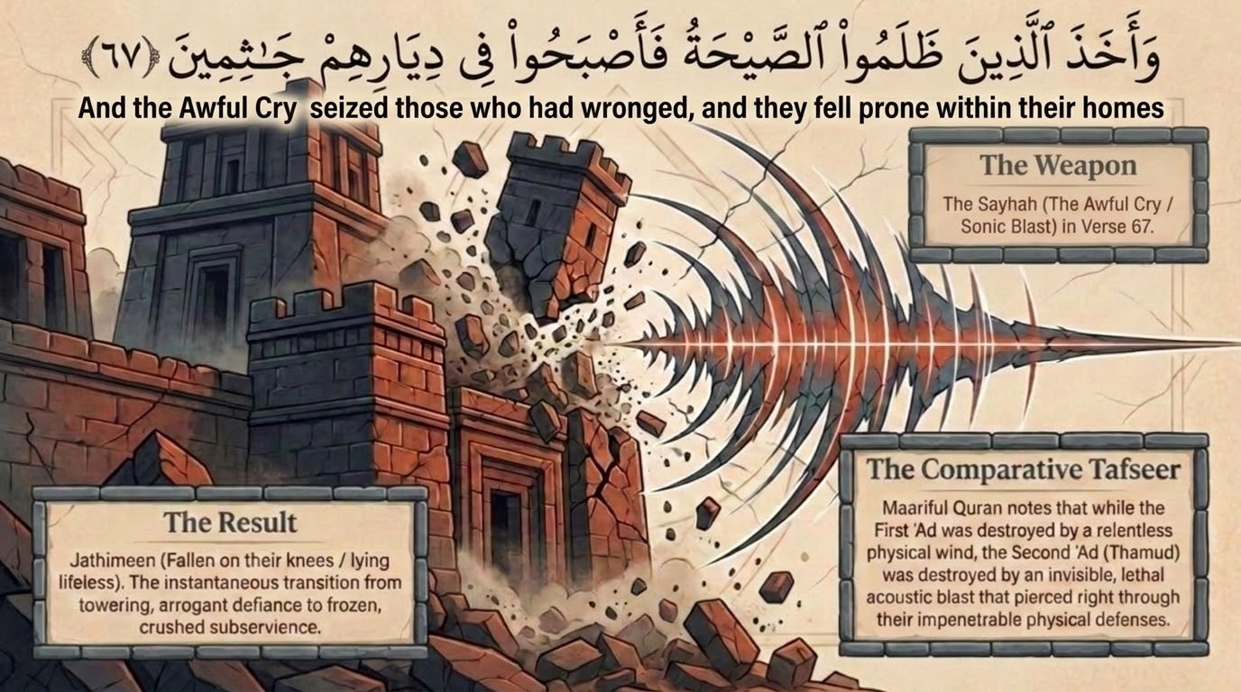
Notes:
Verse 67: 'And the shriek (al-ṣayḥah) seized those who had wronged, and they became, in their homes, fallen prone (jāthimīn) — lifeless on their knees.' Maʿariful identifies the ṣayḥah as a cry so terrible — associated in reports with the archangel Jibrīl — that 'all hearts were rent apart by the horrific sound,' a sonic force beyond what human senses could bear. The deck's 'weapon' is therefore sound itself: the people who trusted in massive stone were undone by a vibration in the air.
On the comparative tafsīr the slide flags: al-Aʿrāf (7:78) says 'the earthquake (rajfah) seized them,' while here and at 41:17 it is the ṣayḥah. Maʿariful, citing Qurṭubī, harmonizes them: there is no contradiction — it is possible the earthquake came first and the blast completed the destruction, or that the single event combined both. Tadabbur: jāthimīn ('fallen prone, motionless on their knees') is the Qurʾān's image of a civilization frozen mid-gesture — caught, in an instant, exactly as they were. The mightiest architecture could not buy them one more motion.

Slide 31
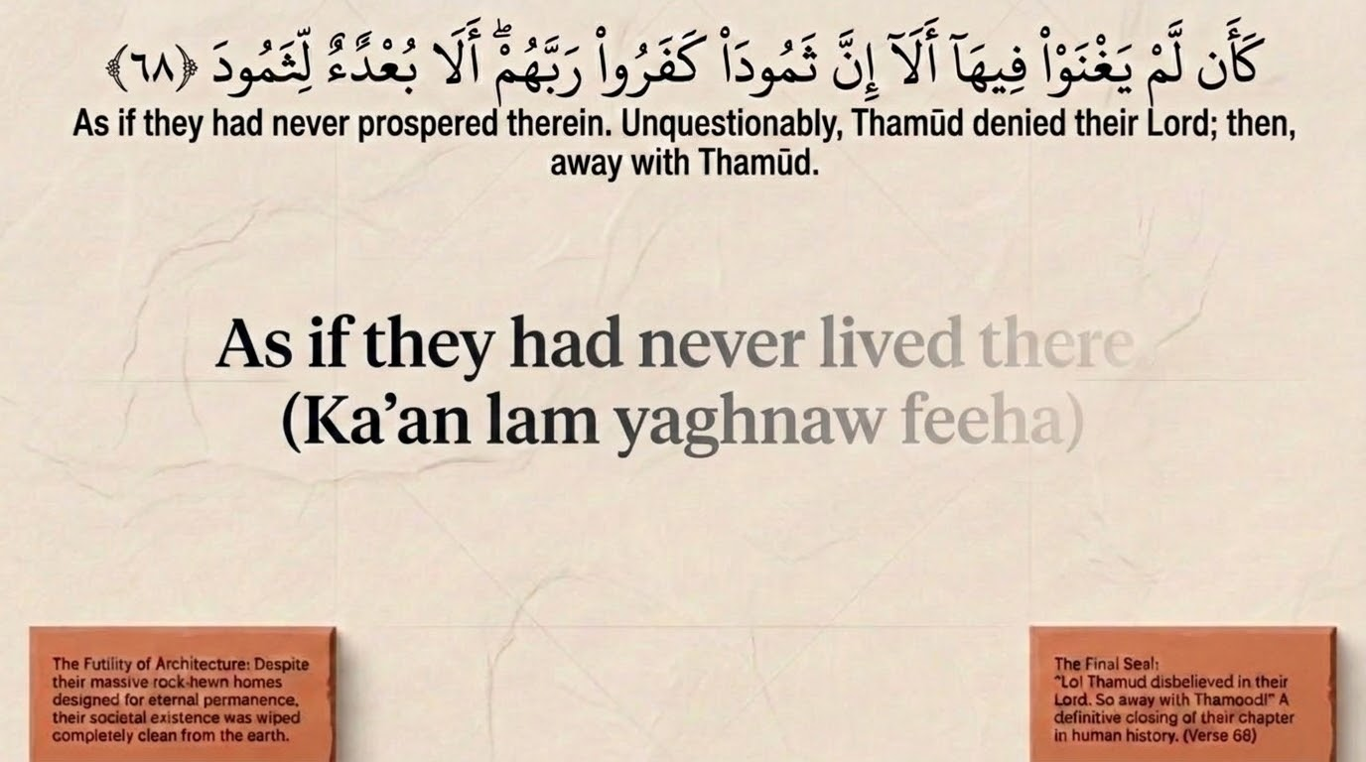
Notes:
Verse 68: 'As if they had never prospered there (ka-an lam yaghnaw fīhā). Unquestionably, Thamūd denied their Lord; so away with Thamūd.' Qutb captures the awe of the scene: 'It is as if they never dwelled or prospered in their magnificent dwellings... Nothing more than a glance separates life from death. The whole life of a human being is no more than a momentary affair.' Their rock-hewn permanence is erased so completely that it is as though they were never there.
The verse closes with the sūrah's verdict-refrain, identical to ʿĀd's at v. 60 — denial of the Lord, then buʿdan ('away with them'). Note the symmetry the deck has been building: two mighty nations, two prophets, two refusals, two identical curses. Tadabbur: 'as if they had never prospered there' is the most sobering phrase in the passage — not merely that they died, but that their whole civilization left no trace in God's reckoning. What, then, of monuments built without Him?

Slide 32
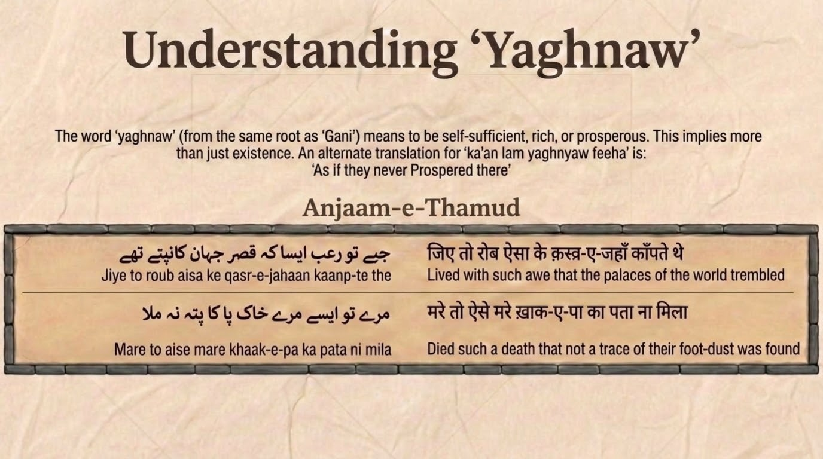
Notes:
Linguistic note on yaghnaw (v. 68). The verb is from gh-n-y; ghaniya bi-l-makān means to dwell in a place and thrive there, to live in it as a settled, flourishing inhabitant (the same root underlies ghinā, richness/self-sufficiency). So ka-an lam yaghnaw fīhā means not merely 'as if they had not lived there' but 'as if they had never thrived, never been well-off, never settled in comfort there' — the erasure reaches their prosperity itself, not only their lives.
The deck pairs the Arabic with the Urdu 'Anjām-e-Thamūd' (the end of Thamūd) and the rendering that they 'died such a death that not a trace of their foot-fixed soil was left.' Tadabbur: the word choice is precise and merciless. A people defined by their flourishing are described, at the end, by the total absence of any flourishing — as if the ghinā they trusted had never existed. The verse does not say they were defeated; it says it was as if they had never been rich at all.

Slide 33
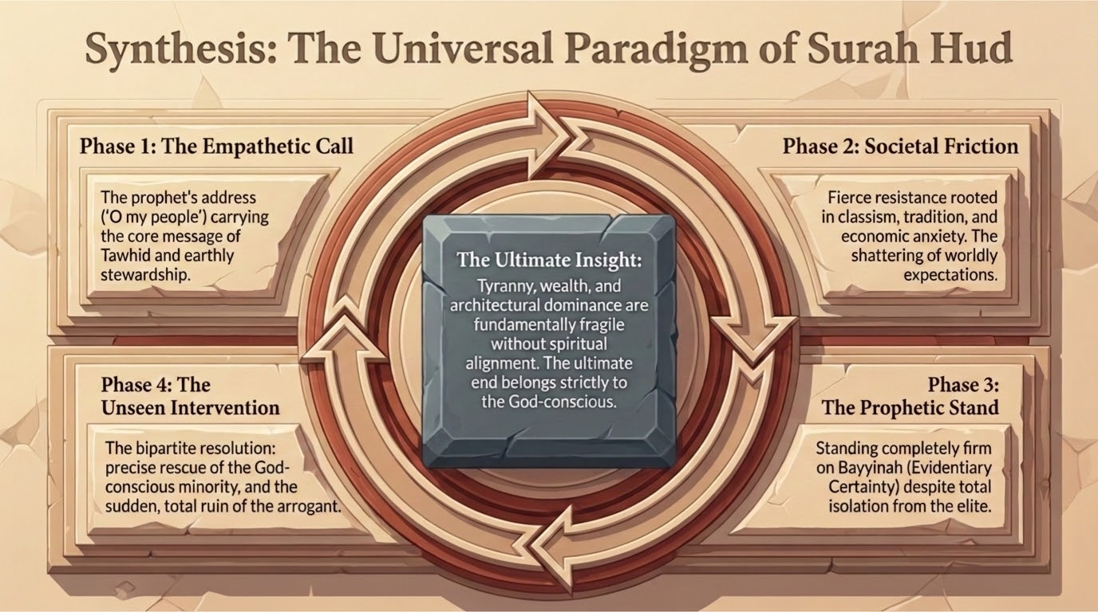
Notes:
Synthesis slide: the universal paradigm of Sūrah Hūd, now visible across three prophet-stories (Nūḥ, Hūd, Ṣāliḥ). The deck's four phases recapitulate the shape we have traced: Phase 1, the empathetic call (a brother calls his people to worship Allah alone, seeking no reward); Phase 2, societal friction (the elite reject, appeal to the fathers, accuse the prophet); Phase 3, the unseen intervention (the decree — flood, wind, cry — that no power can resist); Phase 4, the prophetic stand (the believer's tawakkul and vindication, the remnant saved by mercy).
Tell the group this is the portable lesson: prophetic history is not a series of unrelated catastrophes but a single repeating pattern, exactly as the opening passage (vv. 1–24) claimed. Each story 'historicizes' one of the doctrines of the manifesto — tawḥīd, the futility of idols, the reality of recompense, the return to God. Invite the group to map the matrix from slide 2 onto this cycle: same disease, same diagnosis, same cure, same outcome, across centuries.

Slide 34
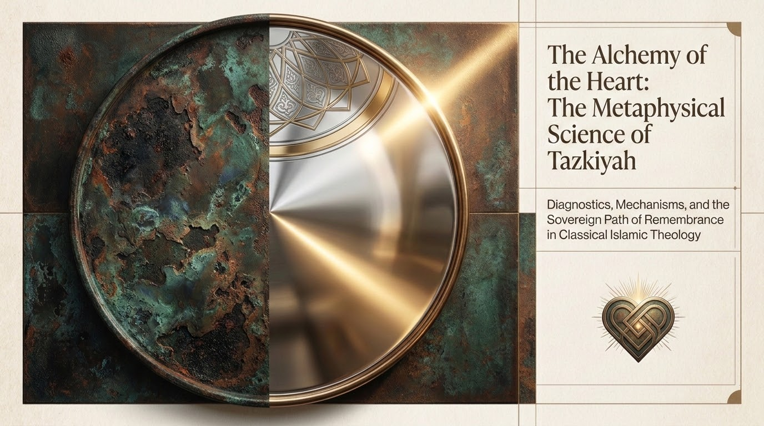
Notes:
Here the deck turns from the outer history of nations to the inner history of the heart — 'the alchemy of the heart,' the metaphysical science of tazkiyah (purification of the self). The pivot is deliberate: the ʿĀd–Thamūd narratives diagnosed civilizations; tazkiyah diagnoses the individual self that builds them. Both run on the same law — outward flourishing without inward submission ends in ruin.
Frame this section honestly for the group. What follows (slides 34–41) is largely a thematic, spiritual-formation framework rather than verse-by-verse tafsīr — it draws on the Qurʾān's language of the heart (qalb), purification (tazkiyah, 91:9), and remembrance (dhikr), and on the broader tradition of the scholars of the heart. Present it as the deck's synthesis of that tradition, grounded where it is explicit in the Qurʾān and Sunnah, and held with appropriate humility where it enters the finer points of spiritual psychology.

Slide 35
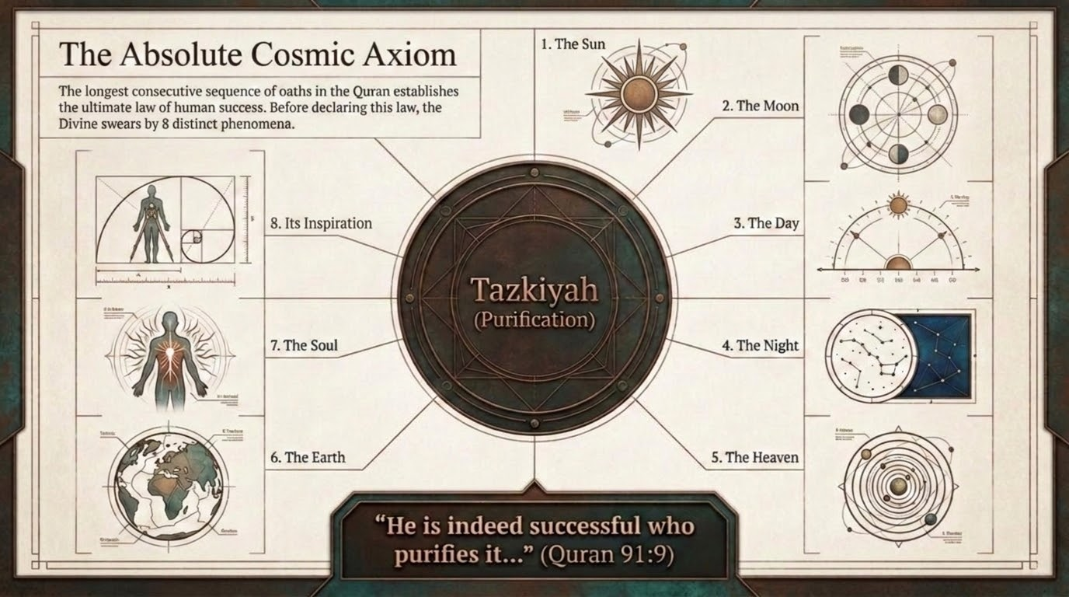
Notes:
The 'absolute cosmic axiom' is Sūrat al-Shams 91:9–10: 'He has succeeded who purifies it (qad aflaḥa man zakkāhā), and he has failed who corrupts it (wa qad khāba man dassāhā).' The deck's claim — that ultimate success is defined by tazkiyah, the purification of the nafs — is squarely Qurʾānic: falāḥ (success) is tied not to wealth, power, or monuments (the very things ʿĀd and Thamūd trusted) but to the cleansing of the self.
This is the inner counterpart to the whole sūrah. Pharaoh, ʿĀd, Thamūd 'corrupted' the self (dassāhā — literally buried it, stunted it) beneath material pride; the saved remnant 'purified' it. Tadabbur: the verse makes purification the one investment that survives the cry, the wind, and the flood. Everything Thamūd built was 'as if it had never prospered'; the only thing that endures is a self made pure before God. Connect this back to v. 23 of Part 1 — the people of paradise are those who 'humble themselves before their Lord' (akhbatū).

Slide 36
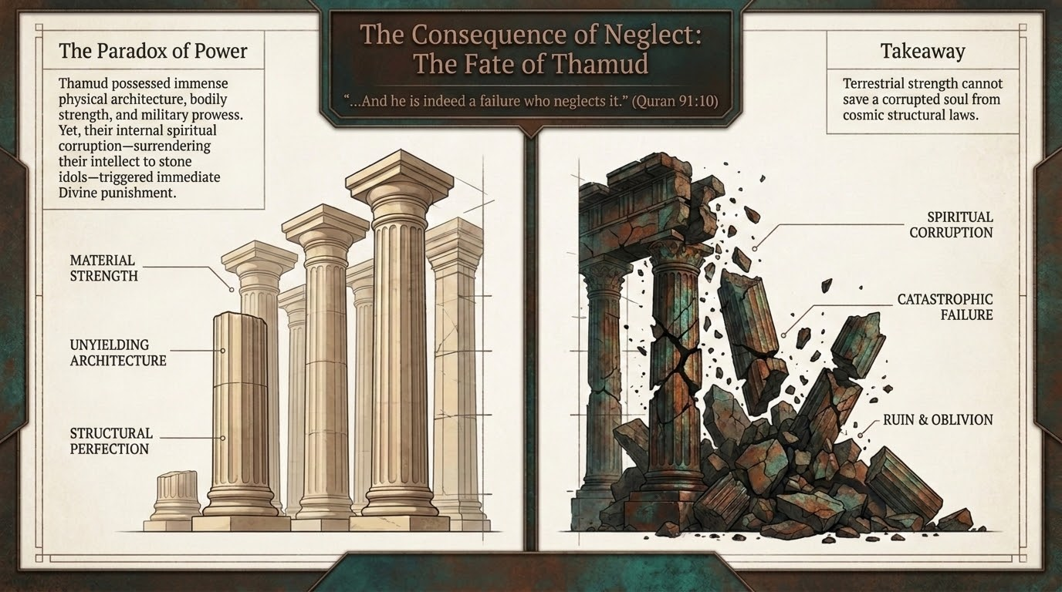
Notes:
The 'paradox of power' applies the Thamūd verdict to the modern eye. Their material evidence was overwhelming — engineering mastery, structural perfection, homes carved to last millennia — and yet the spiritual outcome was total catastrophe. The deck sets these two columns against each other to make the sūrah's point land in our own age of monuments and metrics.
This is the consequence of neglect (ghaflah) writ large: a people can score perfectly on every material measure and fail the only test that is being graded. Recall Qutb on v. 67–68 — 'nothing more than a glance separates life from death' — and Maʿariful's note that their rock-security availed them nothing against a single cry. Tadabbur: we are trained to read strength off of structures (skylines, balance sheets, institutions). The fate of Thamūd warns that structural perfection and spiritual ruin can coexist perfectly — and that only one of them is permanent.

Slide 37
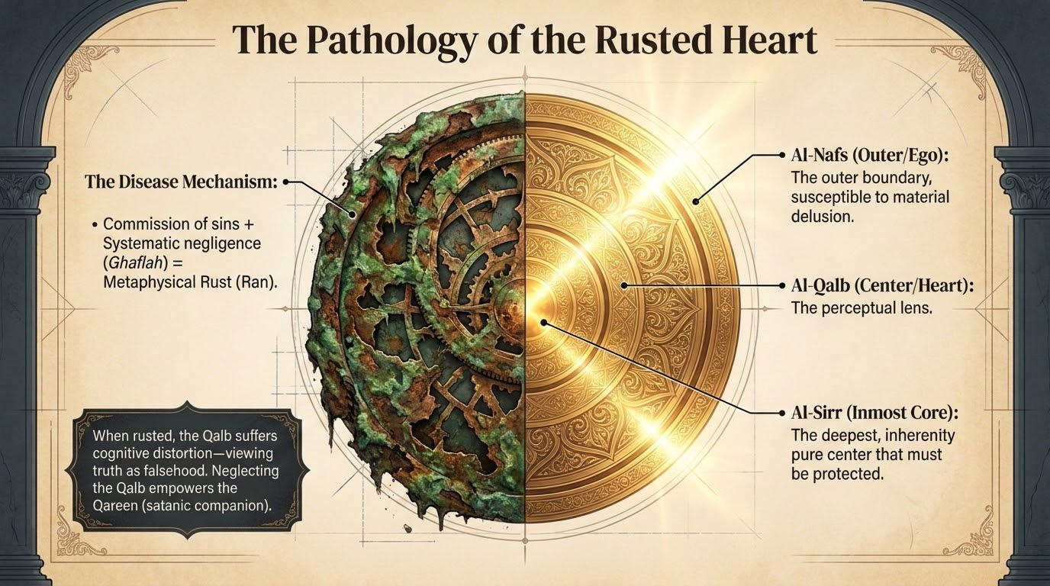
Notes:
'The pathology of the rusted heart' draws on the Qurʾān's own diagnostic image: 'No! Rather, the stain has covered their hearts (rāna ʿalā qulūbihim) from what they were earning' (al-Muṭaffifīn 83:14). The deck's mechanism — sin plus systematic heedlessness (ghaflah) equals metaphysical rust (rān) — is faithful to that verse and to the hadith that each sin leaves a black mark on the heart, until, unrepented, the heart is overlaid and sealed (cf. the hadith of Abū Hurayrah on the spreading stain, narrated by al-Tirmidhī).
The slide's tiered model of the inner self — al-nafs (the outer ego, prone to material delusion), al-qalb (the heart, the perceptual lens), al-sirr (the inmost, pure core to be protected) — belongs to the tradition of the scholars of the heart rather than to explicit tafsīr; present it as a useful spiritual map, not a creedal fixed point. The core teaching is sound and Qurʾānic: when the qalb rusts, it suffers 'cognitive distortion — viewing truth as falsehood,' which is precisely the inversion we watched in ʿĀd and Thamūd, who called the truthful prophet a liar and a madman. Tadabbur: the same rust that doomed nations operates, quietly, in the individual heart; tazkiyah is its only solvent.

Slide 38
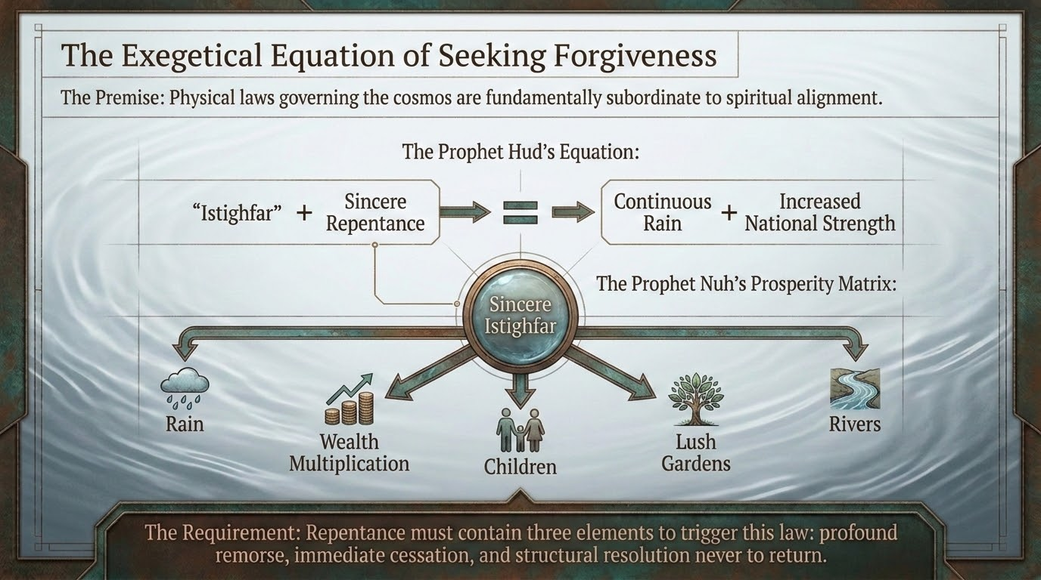
Notes:
'The exegetical equation of seeking forgiveness' returns us to the verse at the heart of this sūrah's promise — Hūd's words at v. 52 (and the sūrah's own at v. 3, and Nūḥ's at 71:10–12): istighfār plus sincere repentance yields increased strength and provision. The deck renders it almost as a formula: physical effort alone is insufficient; it must be aligned with spiritual repair before it bears fruit.
The 'prosperity matrix' references Nūḥ's explicit promise at 71:11–12 — that istighfār brings rain in abundance, wealth, children, gardens, and rivers. Maʿariful, commenting on the sūrah's istighfār-passages, makes the standard point: true repentance is threefold — regret for the past, firm resolve for the future, and concrete action to back the resolve; mere verbal istighfār without resolve is 'the repentance of liars.' Tadabbur: the deck's 'equation' is really the sūrah's recurring sunnah — a people (or a person) who keeps the heart in repair is given the conditions to flourish; ʿĀd and Thamūd are the controlled experiment that proves it by their absence.

Slide 39
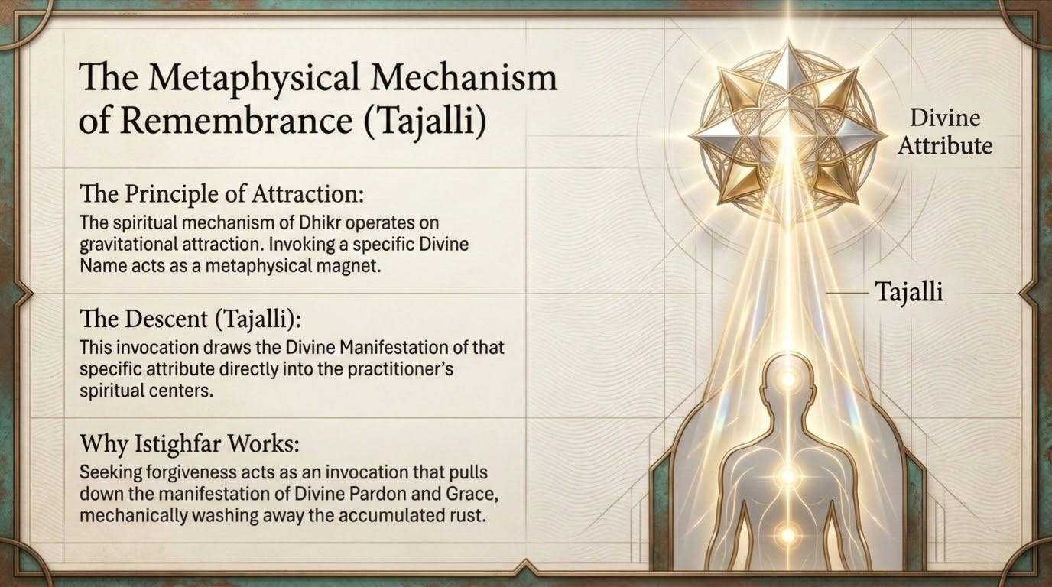
Notes:
'The metaphysical mechanism of remembrance' presents dhikr (remembrance of Allah) as the active engine of purification, with the term tajallī (the disclosure or manifestation of a divine attribute upon the heart). The Qurʾānic anchor is firm: 'Verily, in the remembrance of Allah do hearts find rest (a-lā bi-dhikri llāhi taṭmaʾinnu l-qulūb)' (al-Raʿd 13:28), and 'Remember Me; I will remember you' (al-Baqarah 2:152).
Offer the group a note of balance: tajallī is a term with a rich and sometimes contested history in Islamic spirituality, and the more elaborate metaphysics around it (the 'mechanism' by which a Name 'descends' on the heart) goes beyond what tafsīr establishes; the deck uses it as a devotional model. What is unambiguous and worth dwelling on is the plain Qurʾānic promise: remembrance polishes and settles the heart — the direct remedy for the 'rust' of slide 37. The Prophet ﷺ likened the one who remembers Allah to the living and the one who does not to the dead (al-Bukhārī). Keep the focus there.

Slide 40
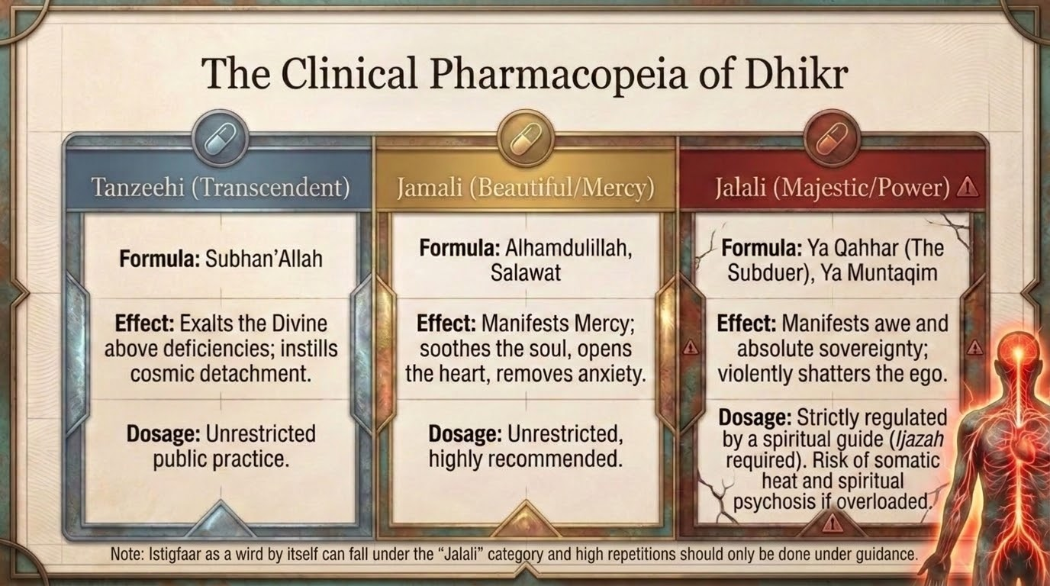
Notes:
'The clinical pharmacopeia of dhikr' organizes forms of remembrance by the kind of divine name they invoke: tanzīhī (transcendence — Subḥān Allāh, declaring God free of all defect), jamālī (beauty and mercy — al-Ḥamdu lillāh, ṣalawāt upon the Prophet ﷺ), and jalālī (majesty and power — names like Yā Qahhār, Yā Muntaqim). The framework, and the cautionary 'dosage' language, reflects a Sufi tradition of guided dhikr rather than explicit tafsīr; present it as such.
Two responsible flags for the group. First, the slide's own note is wise: tasbīḥ, taḥmīd, and ṣalawāt are unrestricted, encouraged practices for everyone, while heavy, repetitive invocation of the names of majesty (jalāl) is the kind of thing the tradition says should be done under qualified guidance — the deck rightly warns against overload. Second, istighfār itself, the sūrah's own prescription (v. 52), is the safest and most universally commended wird of all, directly tied to the rain-and-strength promise we have been tracing. Tadabbur: the everyday adhkār — subḥān Allāh, al-ḥamdu lillāh, astaghfiru llāh, ṣalawāt — are sufficient medicine for most hearts; the exotic is neither necessary nor safe without a guide.

Slide 41
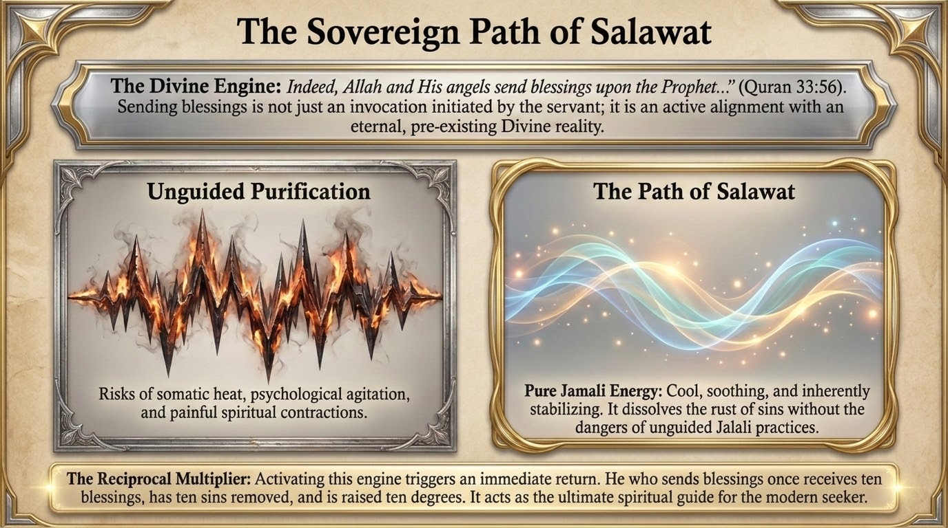
Notes:
'The sovereign path of ṣalawāt' rests on one of the most remarkable verses in the Qurʾān: 'Indeed, Allah and His angels send blessings upon the Prophet. O you who believe, send blessings upon him and greetings of peace (al-Aḥzāb 33:56).' The deck's framing — that ṣalawāt is not an invocation the servant initiates from nothing, but a joining-in of an eternal, pre-existing divine reality already underway — is a beautiful and sound reading of the verse: the believer aligns with an act that Allah and the angels are already performing.
The contrast the slide draws — 'unguided purification' versus 'the path of ṣalawāt' — makes a genuinely useful point: ṣalawāt is a purification whose validity does not depend on the practitioner's own spiritual attainment, because its barakah flows from the Prophet ﷺ and from God's own act, not from the worshipper's state. Hence the hadith that whoever sends one blessing upon the Prophet ﷺ, Allah sends ten upon him (Muslim). Tadabbur: of all the 'medicines' in the previous slide, this is the one the tradition calls safest and most rewarding — a polishing of the heart that carries no risk of overload, because the One who guarantees its effect is Allah Himself.

Slide 42
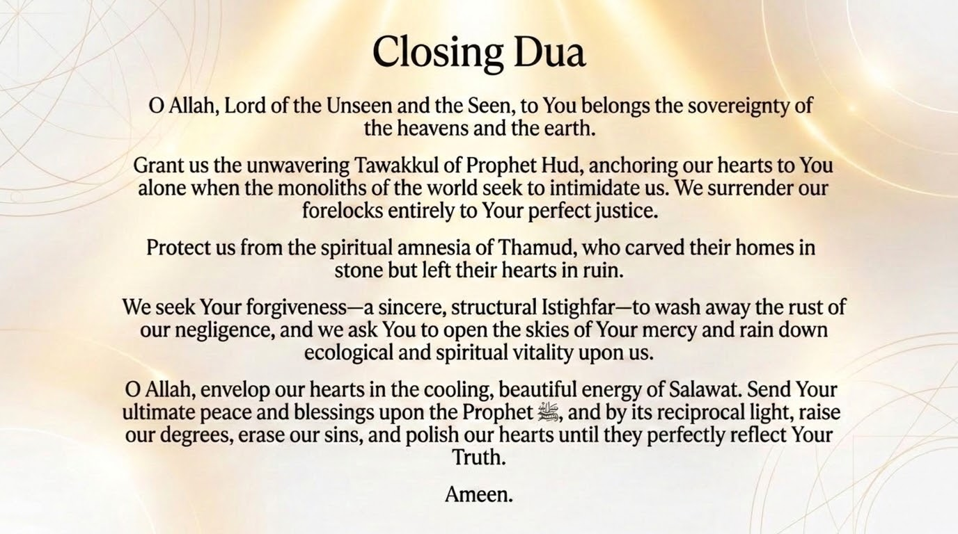
Notes:
The closing duʿāʾ gathers the session's themes. Note how it weaves the two great lessons together: the sovereignty of the Lord of the unseen and the seen (echoing the forelock of v. 56, where every creature is held in His hand), and the futility of monuments built without Him ('the spiritual amnesia of Thamūd, who carved their homes in stone but left their hearts in ruin' — the ka-an lam yaghnaw of v. 68 turned inward).
A sensitivity note for the teacher as you close: these are narratives of total destruction, and the lesson can land heavily. Steer the group, as the duʿāʾ does, toward the merciful door the sūrah keeps open — the Lord who is Qarīb Mujīb (v. 61), Near and Responsive, and the promise of v. 52 that sincere return brings rain, strength, and life. The point of the ruins is not to terrify but to send us back, while the door is open, to istighfār and the polishing of the heart. End, as the duʿāʾ does, on mercy: 'open the skies of Your mercy and rain down ecological and spiritual vitality upon us.' Āmīn.

